Slide 1



Studiul electrochimic al dizolvarii monosulfurilor de fier
CEA - IFA Program
Electrochemical study of iron monosulfide dissolution
Commissariat à l'Énergie Atomique University of Craiova
Michel Schlegel Paul Chirita

Slide 2
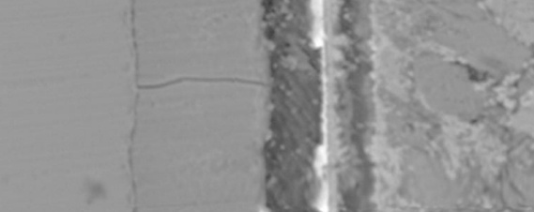
Nuclear waste disposal in clay: the French concept
Long-term storage of nuclear waste as a glass
Glass containers in low-alloy steel overpacks inserted in the clay rock
Heating, clay resaturation, anoxic conditions
Steel (iron) corrosion
Clay transformation
Glass alteration
transport of radioelement through corrosion products & in the near-field
barrier
Insert
barrier
Mechanism of iron corrosion?
Nature and reactivity of corrosion products?
Impact on the fate of radionuclides?
100 µm
Altered glass
Corroded iron
Glass
Clay
De Combarieu, Schlegel et al., Appl. Cheochem., 26, 65-79 (2011)

Slide 3
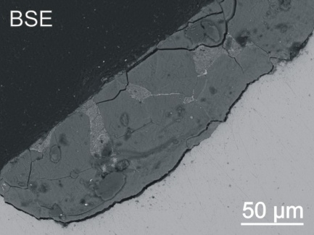
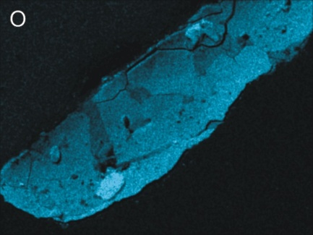
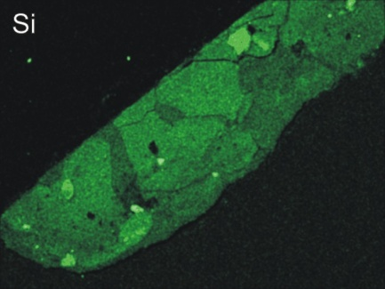
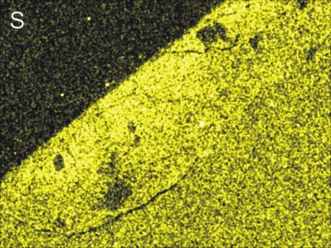
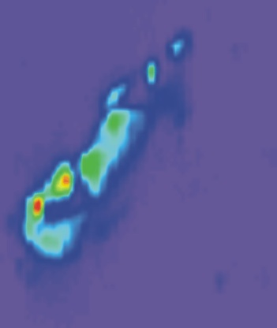
iron monosulfide in corrosion layers
Insight from iron-clay corrosion experiments
SEM-EDX analysis
X-ray absorption spectroscopy
(clay)
S^{(-II)}
S^{(VI)}
Corrosion products
iron
S
3₊
6₊
⁺2
4₊
⁺1
⁺5
Micro X-ray
Fluorescence spectroscopy
S(-II) in iron monosulfide
Potential impact of FeS solid on the retention properties of radionuclides by the near-field clay?
P. Chirita et al, J. Colloid Interf. Sci 321 84-95 (2008).

Slide 4
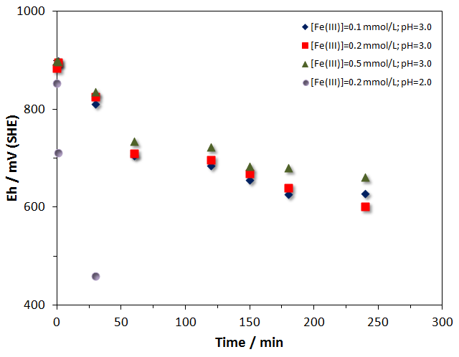
Impact of FeS dissolution on the redox potential
←Before FeS addition
↓Before FeS addition
AfterFeS addition
← AfterFeS addition →
Eh trend at 25 ◦C in [HCl] of 10^{-2.75} and 10^{-3.00}, saturated with air.
Eh trend at 25ºC and [Fe³⁺] ranging from 0.0001 to 0.0005 mol L⁻¹, pH 2 and 3.²
→ Dissolution of iron monosulfide (IMS) buffers the local redox potential and releases Fe^{(II)} and sulfur species in intermediate oxidation states, which can maintain reducing conditions in the clay
Chirita P., Descostes M., Schlegel M.L. J. Colloid Interface Sci 321 84–95 (2008).
Chirita P., Schlegel M.L. Goldschmidt 2011, Prague, Czech Republic.

Slide 5
Project objectives
Clarification of the reaction kinetics and mechanisms of sulfur-bearing species release during IMS dissolution, and the impact of redox active species transport in media around radionuclide repositories.
Activities
Electrochemical investigation of IMS dissolution reactions
Characterization of solid reaction products formed on surface of IMS electrodes using specific surface science techniques
Identification of the main factors controlling IMS dissolution
Development of theoretical models to estimate the redox buffer potential of IMS

Slide 6
Electrochemical study of FeS dissolution in presence of O_{2(aq)}: pH effect
Potentiodynamic polarization behavior of FeS dissolved in HCl solutions at 30ºC and pH from 2.5 to 5.0
Dependence of –lg i₀ versus pH
→ i₀ decreases from 6.7x10⁻⁵ to 1.76x10⁻⁶ A/cm² when pH increases from 2.5 to 5.0
→ Reaction order with respect to [H⁺] is 0.67

Slide 7
FeS dissolution in presence of O_{2(aq)}:
Impedance behavior
Impedance behavior of FeS in HCl solutions at 30ºC and pH 2.5 and 3.0 (a) and pH from 2.5 to 5.0 (b). R_{ct} increases from 0.25 to 19.76 KOhm when pH increases from 2.5 to 5.0

Slide 8
FeS dissolution in presence of O_{2(aq)}: Temperature effect
Potentiodynamic polarization behavior of FeS dissolved in HCl solutions with pH 2.5
→ i₀ increases from 6.70 x 10⁻⁵ to 1.25 x 10⁻⁴ A/cm² when temperature increases from 30 to 55ºC
Determination of activation energy for FeS oxidation by O_{2(aq)} in HCl solution with pH 2.5 and temperature ranging from 30 to 55ºC
→ Activation energy 24.49 kJ/mol

Slide 9
Effect of treatments on FeS dissolution in presence of O_{2(aq)}
Variation of pH with time during the dissolution of FeS (either untreated or pre-treated) in presence of air
Variations of [Fe_{(aq)}] with reaction time for FeS either untreated or pre-treated
Chirita P., Schlegel M.L. (2011) The effect of solid pre-treatments on FeS dissolution. Surf. Interf. Analysis (submitted).

Slide 10
Dissolution rates as a function of time and sample pre-treatment
X-ray patterns of initial FeS sample (down); FeS treated with water (middle) and FeS sample treated with HCl (up)
Schematic representation of rate control during dissolution process of untreated FeS

Slide 11
Conclusions
FeS dissolution in presence of O_{2(aq)} is influenced by pH and temperature:
- the reaction order with respect to [H⁺] is 0.67
- the activation energy is 24.49 kJ/mol
The activation energy indicates that FeS dissolution in presence of O_{2(aq)} is controlled by diffusion and surface reaction
In similar conditions (30ºC and pH 3.5), the reactivity of FeS (i₀= 1.19 x 10⁻⁵ A/cm²) is greater than FeS₂ (i₀= 3.97 x 10⁻⁷ A/cm²). This suggests that FeS may react more rapidly to O₂ ingress

Slide 12
Cooperation perspectives
→ On-going study of the electrochemical study of IMS dissolution:
Investigation of IMS dissolution in anoxic conditions
Investigation of IMS dissolution in presence of Fe³⁺_{(aq)};
Clarification of the IMS dissolution mechanisms.
→ Development of common research topics, with elaboration of joint proposals under international and European Programs and Initiatives.
→ Exchange of scientists and specialists between CEA and UCV.
Support from IFA-CEA Program (Project C1-04) and CEA-SINF “Aval du cycle” are gratefully acknowledged.

Slide 13
Thank you

