Slide 1
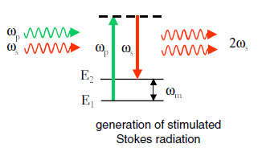
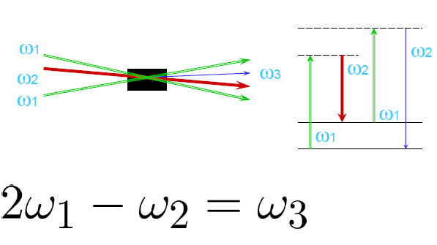
Stimulated
Raman Scattering
Coherent
anti-Stokes Raman Scattering

Slide 2

A. Surface Enhanced Raman Scattering (SERS) as
nonlinear optical effect.
B. New features of the Raman spectra of single-walled
carbon nanotubes highly separated into
semiconducting (99%) and metallic (98%) components.
I.Baltog, M.Baibarac, L.Mihut,

Slide 3
Outline
A • Background of Raman light scattering
• Methods of amplification of the Raman emission
• Surface Enhanced Raman Scattering (SERS) via plasmons excitation
• SERS mechanism as a nonlinear optical process.
B• Brief introductions in the Raman spectroscopy of carbon nanotubes
• Abnormal Anti-Stokes SERS spectra of single-walled carbon nanotubes as
single beam CARS effect .
• Anti-Stokes and Stokes SERS spectra of single-walled carbon nanotubes
highly separated into semiconducting (99%) and metallic (98%) nanotube
components.
C • Summary

Slide 4
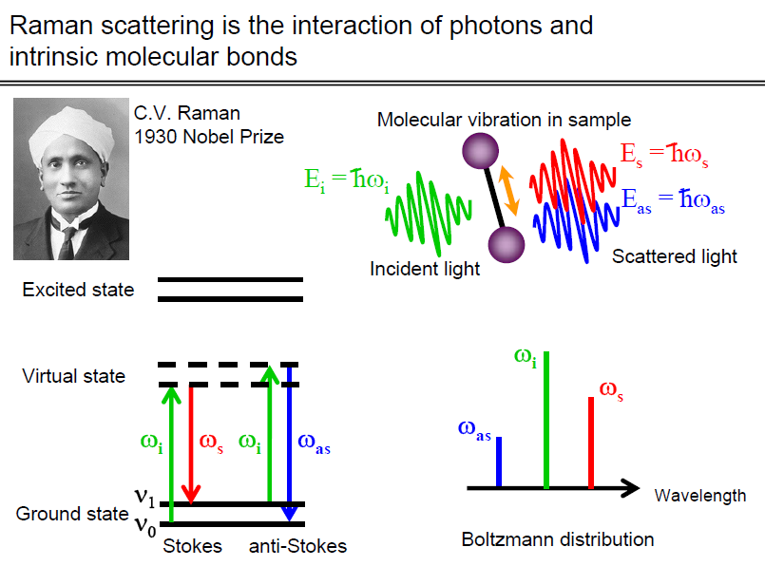
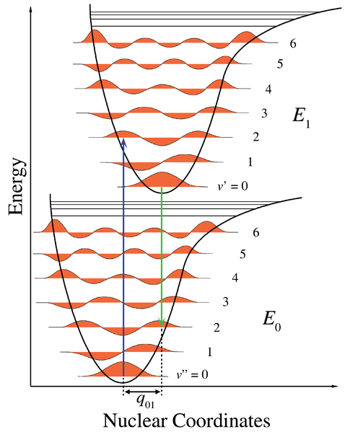
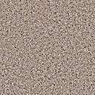
Virtual levels Electronic levels
Excitation
Excitation
Excitation
Excitation
Raman anti-Stokes
Raman anti-Stokes
Raman Stokes
Raman Stokes
v₃
v₂
v₁
v₀
v₃
v₂
v₁
v₀

Slide 5
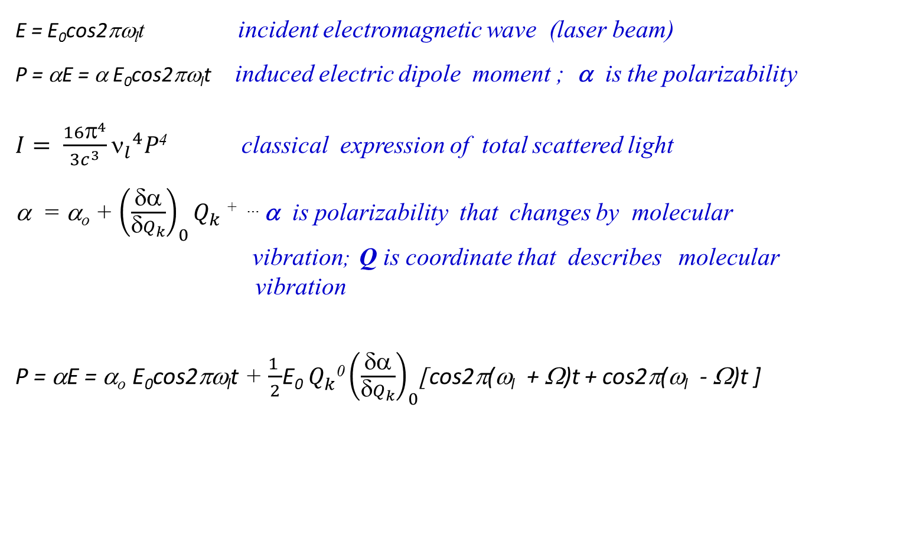
Raman light scattering is an complex interaction of photons
and intrinsic molecular bonds
E = E₀cos2πω_{l}t incident electromagnetic wave (laser beam)
P = αE = α E₀cos2πω_{l}t induced electric dipole moment ; α is the polarizability
$I= \frac{16π^{4}}{3c^{3}}{ν_{l}}^{4}P$⁴ classical expression of total scattered light
α = α_{o} + ${\left(\frac{δα}{δQ_{k}}\right)}_{0}Q_{k}$ ^{+ …} α is polarizability that changes by molecular vibration; Q is coordinate that describes molecular
vibration
P = αE = α_{o} E₀cos2πω_{l}t + $\frac{1 }{2}$E₀ $Q_{k}^{}$⁰ ${\left(\frac{δα}{δQ_{k}}\right)}_{0}$[cos2π(ω_{l} + Ω)t + cos2π(ω_{l} - Ω)t ]
Rayleigh
scattering
Anti-Stokes Stokes
Raman scattering
Both branches are amplified equally
with the excitation light intensity
Intensity
Values at
~ 1500 cm⁻¹
I(ω_{l}) >> I_{S} >> I_{aS}
1 >> 10⁻⁶ >> 10⁻⁹

Slide 6
Information from Raman spectroscopy
Characteristic Raman
frequencies
PbI₂ ; ZnO ; CCl₄ ; TiO₂
C_{60;} SWNTs; graphene
Changes in frequency
of Raman peak
Chemical interaction;
stress; strain; temperature
║
Polarization
of Raman peak
Crystal symmetry ;
orientation; antenna effect.
┴
Morphology: crystal;
mesoscopic and nanometric
structures;
Width
of Raman peak
• Amount of material;
film thickness;
• Nonlinear optical
effects
Intensity
of Raman peak

Slide 7
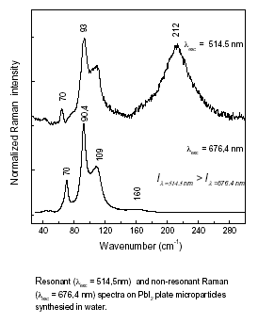
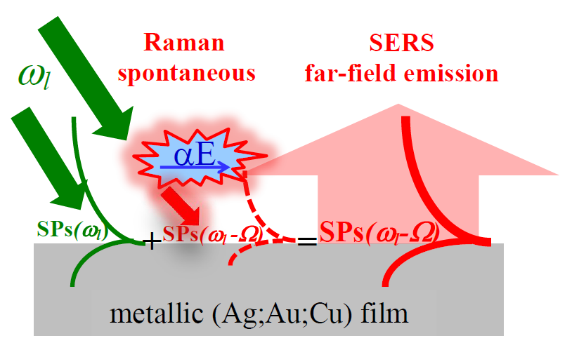
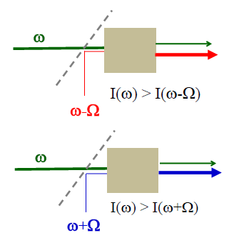
Methods of amplification of the Raman emission
Resonant excitation
SERS effect
chemical + plasmons
B.C
SERS
chemical
676.4 nm
514.5 nm
B.V
x 10⁴
SERS
plasmons
x10⁴ -10⁶
SERS plasmons
Stimulated Raman effect
CARS effect
ħ(2ω_{P} – ω_{S})
ω_{S}
ω_{aS} = 2ω_{P} – ω_{S}
k_{aS} =2k_{P} -k_{S}
ω_{p}
ħω₁
ω_{p}-ω_{S}=Ω
k(ω₁)
k(2ω₀-ω₁)
x10⁴-10¹⁰
x10⁴-10⁸
k(ω₀)
k(ω₀)

Slide 8
Abnormal anti-Stokes SERS spectra of CuPc under resonant
excitation
1
2
1
2
λ_{exc} = 647.1 nm is resonant for CuPc

Slide 9
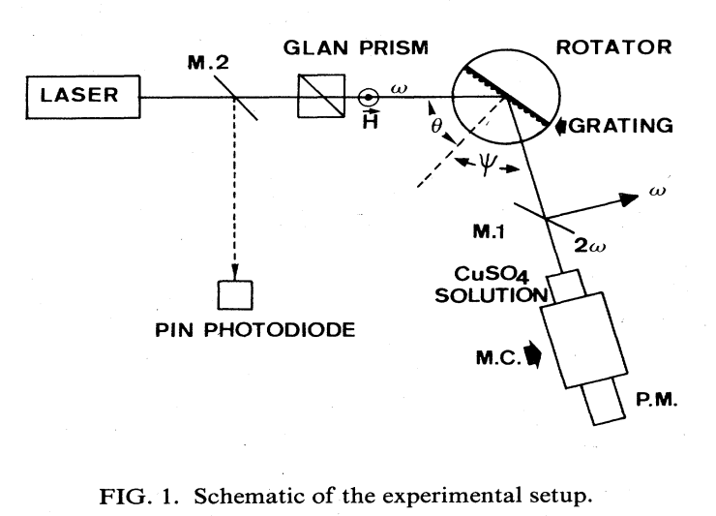
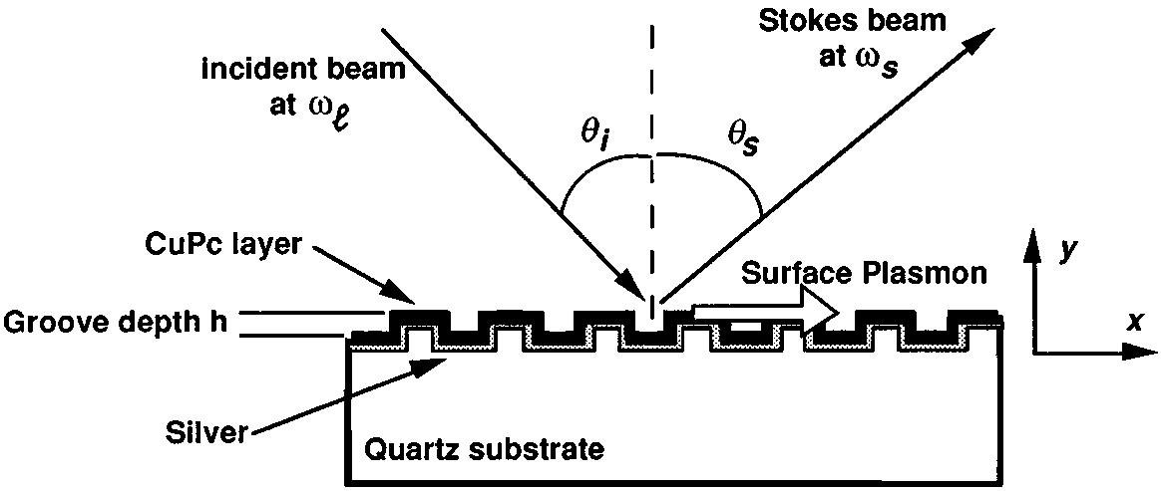
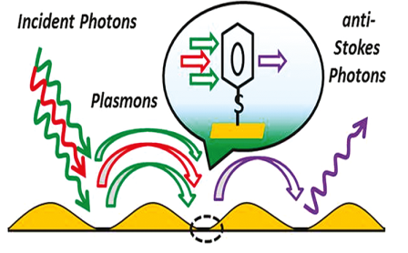
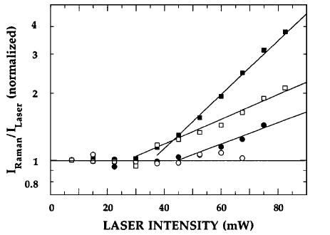
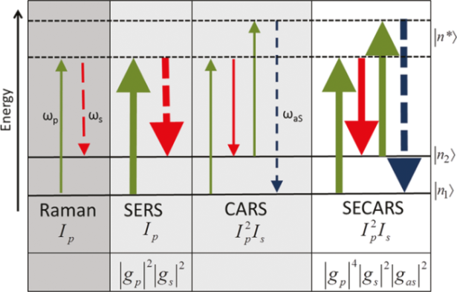
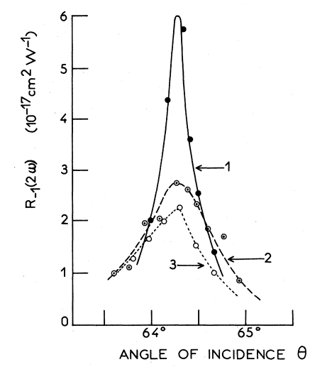
Surface plasmons as a channel to generate by optical
pumping non-linear effects.
CARS effect
• Single beam :
I.Baltog et al. Phys. Rev. B,72,(24), 245402,(2005)
J.Appl.Phys,110, 053106,(2011)
• Double beams
Second harmonic
generation
Stimulated Raman
effect
I_{L} >> I_{S} ω_{L} + Ω ☛ CARS
ω = ω_{L}± (ω_{L} – ω_{S}) =
ω_{S} ☛ Stimulated
Raman
I.Baltog et al. J.Opt.Soc.Am.,13, 656,(1996)
C.Steuwe, et al. Nano Lett. , 11, 5339;(2011)
RL Aggarwal ; et al. Appl. Spectrosc.. 67 ,
132-135 ,(2013)
J.L.Coutaz et al. Phys Rev B,32,227,(1985)

Slide 10
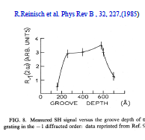
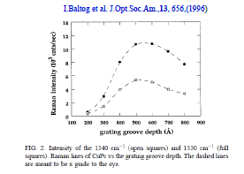
Second harmonic
generation
Stimulated Raman
effect

Slide 11
p-polarization:
E-field is parallel to the plane
of incidence
s-polarization:
E-field is perpendicular to the plane of incidence
(German senkrecht = perpedicular)
E_{z}
H_{z}
E
H
H_{y}
E_{x}
E_{y}
H_{x}
θ₁
ε₁
θ₁
ε₁
z=0
z=0
y
ε₂
y
ε₂
x
x
θ₂
θ₂
z
z
Any linearly polarized radiation can be represented as a superposition of
p - and s - polarization.

Slide 12



•p-polarized incident radiation will
create polarization of charges at
he interface.
•These charges give rise to a surface plasmon modes
Boundary condition:
(a) transverse component of E is conserved,
(b) normal component of D is conserved
E_{1z}
E₁
z=0
H_{1y}
E_{1x}
ε₁
E₂
y
E_{2z}
ε₂
creation of the polarization charges
x
H_{2y}
E_{2x}
if one of the materials is metal, the electrons will respond to this polarization. This will give rise to surface plasmon modes
z

Slide 13

s-polarized incident radiation does not create polarization charges at the interface. It thus can not excite surface plasmon modes
Boundary condition
(note that E-field has a transverse component only):
transverse component of E is conserved,
H_{1z}
H₁
z=0
E_{1y}
H_{1x}
ε₁
H₂
y
H_{2z}
no polarization charges are created →
no surface plasmon modes are excited!
ε₂
x
E_{2y}
H_{2x}
z

Slide 14
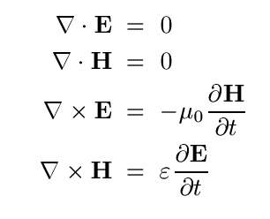


Maxwell’s equations
Surface Enhanced Raman Scattering
(SERS)
via plasmons excitation
Charge neutrality, ρ = 0
No direct current, j = 0
Non-magnetic materials, μ_{r} = 1 (μ = μ₀)
condition imposed on k-vector
E_{1z}
E₁
dielectric ε₁
E_{1x}
intensity
y
x
wave propagating
in x-direction
localized surface mode = surface plasmon
decaying into both materials
z
metal ε₂

Slide 15
Caracteristicile undelor de suprafata = plasmoni de suprafata (SP) :
undele de suprafata rezulta din oscilatiile colective ale electronilor din stratul metalic ; pot fi excitate numai cu radiatie cu polarizata p (TM), care are o componenta EM perpendiculara la suprafata
undele de suprafata sunt propagative in lungul suprafetei de separare dintre doua medii (metal-dielectric) aflate in contact;
pentru λ_{exc} = 500 nm; L_{propagare}≈ 25 μm
(ii) unde evanescente pentru care amplitudinea scade exponential cu distanta de la suprafata de separare –
pentru : λ_{exc} = 500 nm; h_{penetrare} ≈ 12 nm in metal si ≈ 95 nm in aer
amplitudinea undei evanescente este maxima in lungul suprafetei lor de separare
(iv) Metale active Pb, In, Hg, Sn, Cd → UV si Cu, Au, Ag → VIS

Slide 16
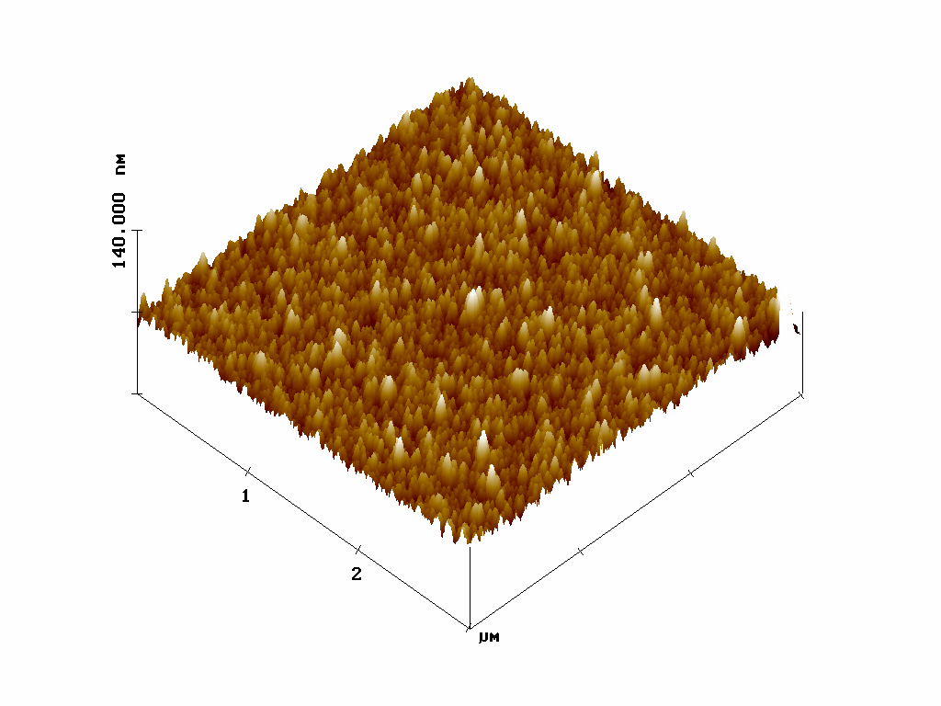
METHODS OF PLASMON EXCITATION
dielectric ε₁
θ₁
prism
metall ε₂
θ₁
prism
coupling gap
metal
metal
Otto geometry
Kretschmann-Raether
geometry
Grating
⬅ rough surface ⬅

Slide 17
Experimental
Material:
- copper-phthalocyanine (CuPc)
- SWNTs highly separated in semiconducting (99%) and metallic (98%)
components
Sample form :
- thin films (9.5; 39; 88; 185 nm thickness ) deposited on glass and
rough Au and Ag supports with different SERS activity;
motivation: SERS(Au) << SERS(Ag)
Measuring geometry : Backscattering under focused light ; x50 aperture objective
Excitation laser light : 514.5 ; 647.1;676.4 nm ensuring non-resonant and
resonant optical excitation

Slide 18
Abnormal anti-Stokes SERS spectra of CuPc under resonant
excitation
1
2
1
2
λ_{exc} = 647.1 nm is resonant for CuPc

Slide 19
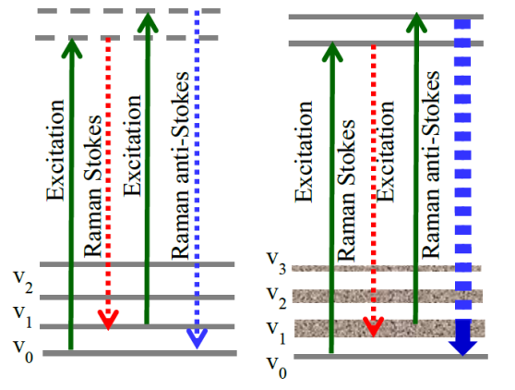
SERS spectroscopic studies on CuPc thin films under
non-resonant ( 514.5 nm) and resonant (647.1 nm) optical excitation.
SRS
CARS
Anti-Stokes and Stokes Raman spectra of CuPc thin
Films of 39 nm thickness deposited on Ag, Au and
glass supports. Red curves show the anti-Stokes
spectra calculated with the Boltzmann formulae
applied to the corresponding Stokes
Raman spectra.
Anti-Stokes and Stokes Raman spectra of CuPc thin
Films of 39 nm thickness deposited on Ag, Au and
glass supports. Red curves show the anti-Stokes spectra
calculated with the Boltzmann formulae applied to the
corresponding Stokes Raman spectra.

Slide 20
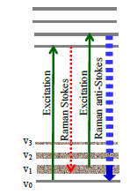
for a Raman line at ~1500 cm⁻¹
I(ω_{L}) >> I(ω_{S}) >> I(ω_{aS})
1 10⁻⁶ 10⁻⁹
SP(ω_{L}) >> SP(ω_{S}) >> SP(ω_{aS})
SP(ω_{L}) → SP(ω_{S}) = SRS
I(ω_{L}) >> I(ω_{S}) ≈ I(ω_{aS})
1 10⁻⁶ 10⁻⁶
SP(ω_{L}) >> SP(ω_{S}) > SP(ω_{aS})
SP(ω_{L}) → SP(ω_{S}) SRS
(2SP(ω_{L}) ± SP(ω_{S})) → SP(ω_{aS}) CARS
Intensities of the anti-Stokes and Stokes Raman lines
at 1530 cm⁻¹ of 39-nm-thick CuPc films deposited on
glass, Au and Ag supports. Raman measurements were
performed in a backscattering geometry under non-resonant (514.5 nm) and resonant (647.1 nm) optical excitations.
Data were all obtained at the same laser intensity (2 mw)
focused by a 50x objective onto the surface sample.
Data for each Raman branch were normalized to the
intensity measured on the film deposited on a
glass support.
SRS

Slide 21
Diagrams of variations of the anti-Stokes
and Stokes Raman line at 1530 cm⁻¹ of
CuPc at different excitation wavelength
( non-resonant : 514.5 and resonant :
647.1 nm), film thickness (9.5, 39 and 88 nm)
and substrates used glass, Au and Ag.
Intensities one each branch were normalized
to the value measured on glass substrate.

Slide 22
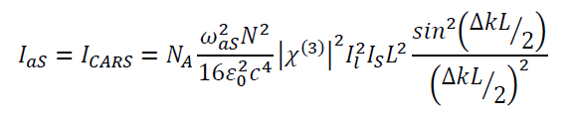
A₂
Film thickness matched by plasmons wave penetration depth
I(ω_{L}) >> I(ω_{S}) ≈ I(ω_{aS})
1 10⁻⁶ 10⁻⁶
SP(ω_{L}) >> SP(ω_{S}) ≈ SP(ω_{aS})
SRS
SP(ω_{L}) → SP(ω_{S})
CARS
(2SP(ω_{L}) ± SP(ω_{S})) → SP(ω_{aS})
Intensity of the anti-Stokes and Stokes Raman line at
1560 cm-1 of CuPc thin films of 9.5 nm thickness
deposited on glass, Au and Ag supports under
non-resonant (514.5 nm) and resonant (647.1 nm)
laser excitation.Data were normalized to the intensity
obtained on glass support.

Slide 23

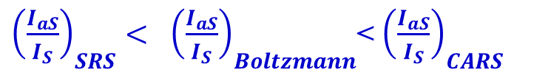
 SERS mechanism can be considered a nonlinear optical process ?
Yes, this is demonstrated by the deviations from the Boltzmann law.
Plasmons coupling mechanism
I(ω_{l}) > I(ω_{S}) > I(ω_{aS})
SPs(ω_{l}) > SPs(ω_{S}) > SPs(ω_{aS})
${\left(\frac{I_{aS}}{I_{S}}\right)}_{SRS}< {\left(\frac{I_{aS}}{I_{S}}\right)}_{Boltzmann}$< ${\left(\frac{I_{aS}}{I_{S}}\right)}_{CARS}$
mixing of surface waves (SW)
SW(ω₁) + SW(ω_{S}) + SW(ω_{aS})
ω_{mix} = ω_{L}± (ω_{L} – ω_{s})
ω_{mix} = ω_{L}- (ω_{L} – ω_{s}) = ω_{s}
lower frequencies are amplified at the expense of the higher frequencies
Stimulated Stokes Raman effect (SRS)
SRS
ω_{mix} = ω_{L}+ (ω_{L} – ω_{s}) = 2ω_{L}- ω_{S} = ω_{L}+ Ω = ω_{aS}
higher frequencies are amplified at the expense of the lower frequencies
Coherent anti-Stokes Raman effect (CARS)
CARS

Slide 24
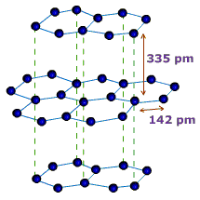
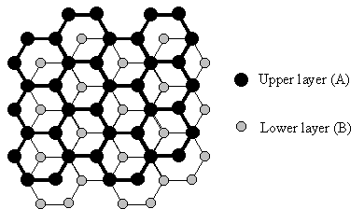
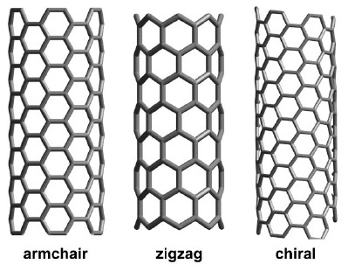
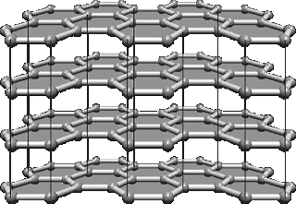
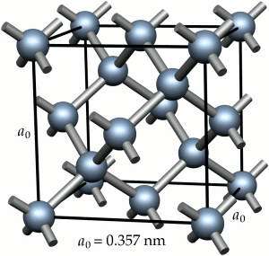
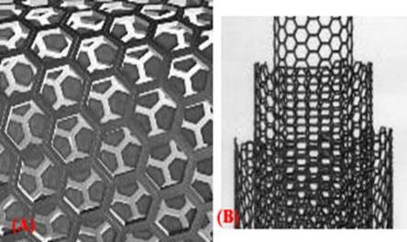
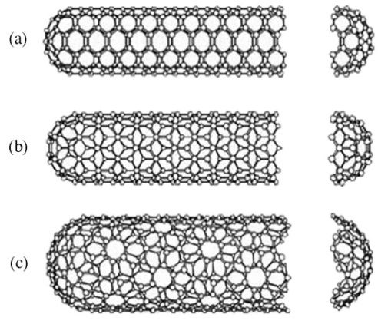
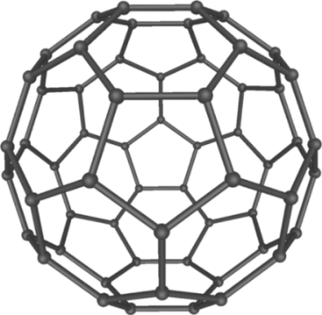
Carbon allotropic particles
Graphite
Graphene
metallic
semiconductor
Diamond
Multi-wall carbon
nanotubes
Single wall carbon nanotubes
Fullerene : C₆₀

Slide 25
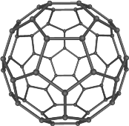
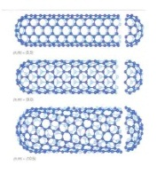
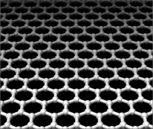

Carbon nanoparticles
1996 Nobel prize Chemistry | Robert F. Curl Jr., Harold W. Kroto, Richard E. Smalley | Fullerene
2008 Inaugural Kavli Prize for Nanoscience | Sumio Iijima | Carbon nanotubes |  | λ_{exc} = 647.4 nm λ_{exc} = 514.5 nm
2011 Nobel prize Physics | Andre Geim, Konstantin Novoselov | Graphene |  | λ_{exc} = 457.9 nm

Slide 26
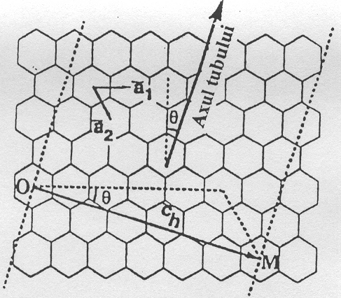
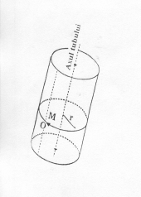
Geometry of single-walled carbon nanotube (SWNT)
d = C_{h} / π = 3^{1/2}a_{C-C}(m² + mn + n²)^{1/2}/ π
= tan⁻¹[3^{1/2}m/(m+2n)]
N(hex/u.c) = 2(m² + mn + n²)/d
(n,m) denote the number of unit vectors na₁ si ma₂
in the hexagonal honeycomb lattice contained in the
vector C_{h}
θ chiral angle
a_{C-C} = 1.421 Ǻ is the nearest-neighbor C-C distance in graphite
n,m,θ define a specific SWNT:
► Armchair (n = m,θ =30⁰ ),
► Achiral or zig-zag (n ≠ 0 or m = 0 ; θ = 0⁰ )
► chiral (n ≠ m ≠ 0 ; 0⁰<θ <300 ).
for n-m = 3k , k = 1,2,3.. Metallic properties
for n-m ≠ 3k Semiconducting properties
θ = 0⁰ ; θ = 30⁰ ; 0<θ<30⁰

Slide 27
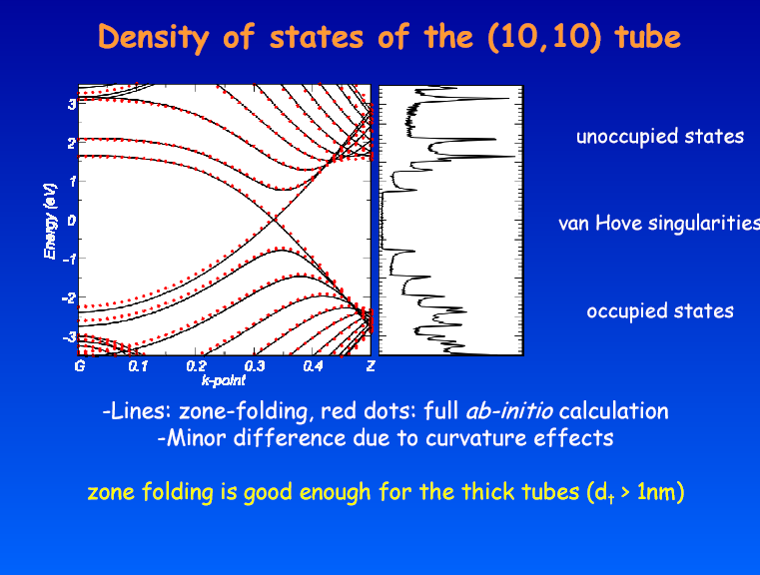
Electronic structure
- SWNT has one-dimensional (1D) electronic density of states
1D electronic band structure derive from the 2D band structure
of the graphene honeycom sheet.

Slide 28
► The structure of electronic bands density of an one dimensional system (1D- carbon nanotube) derives from
the bi dimensional structure (2D) of graphite
► A set of 1D energy dispersion relations is obtained by slicing up the 2D energy band structure of graphite in the
circumferential direction.
where a = 1.42 x Ǻ =2.46 Ǻ is lattice constant of two dimensional graphite k_{x} and k_{y} are the corresponding basis vectors of the reciprocal lattice; γ₀ is nearest-neighbor transfer integral
For an armchair SWNT tube the 1D energy dispersion relation is:
(-π < ka < π ); m = 1,.....,5 ;
Similarly for a zig-zac SWNT tube:
m = 1,.....,9 ;
k is one dimensional vector along the tub axis
► The calculations for the electronic structure of SWNTs show that about 1/3 of the nanotubes are metallic and 2/3
are semiconducting , depending on the nanotube diameter d_{t} and chiral angle θ.
►The metallic SWNT have a small non-vanishing 1D density of states at the Fermi level while for the semiconducting
1D SWNT the density of states is zero.
► The band gap for isolated semiconducting carbon nanotubes is proportional to the reciprocal nanotube diameter 1/d_{t}

Slide 29
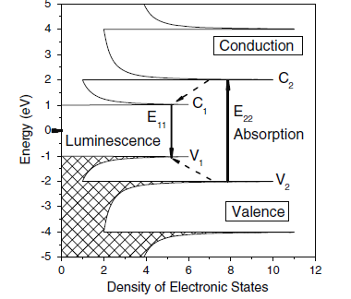
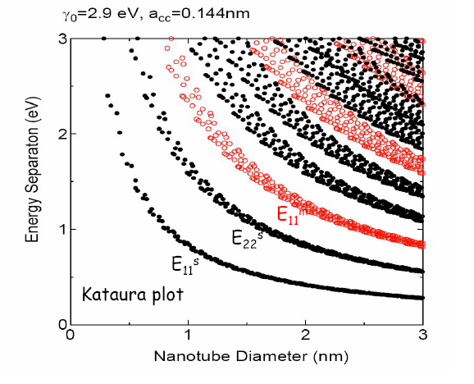
The tubes diameter and calculated band gap energies as function of n,m, θ parameters .
514.5 nm
2.4 eV
676 nm
1.83 eV
1064 nm
1.16 eV
Absorption spectrum of SWNT

Slide 30
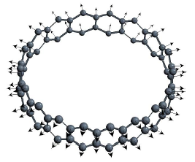
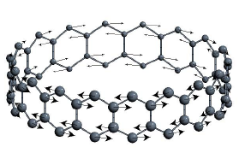
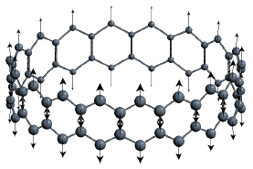
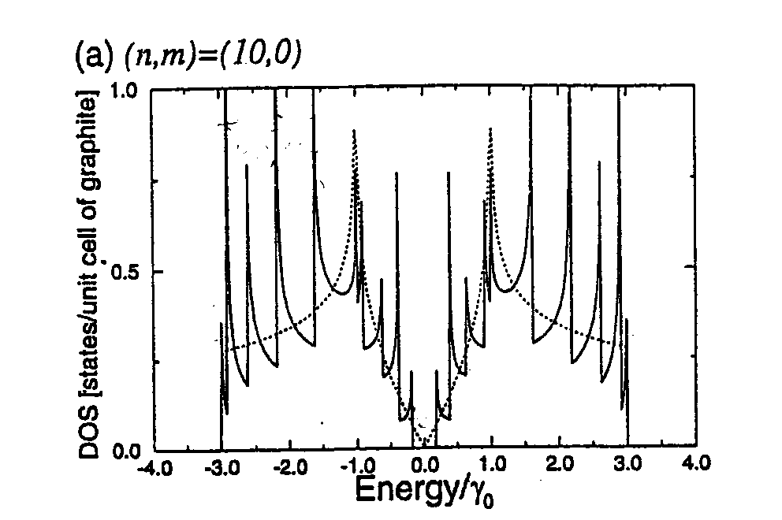
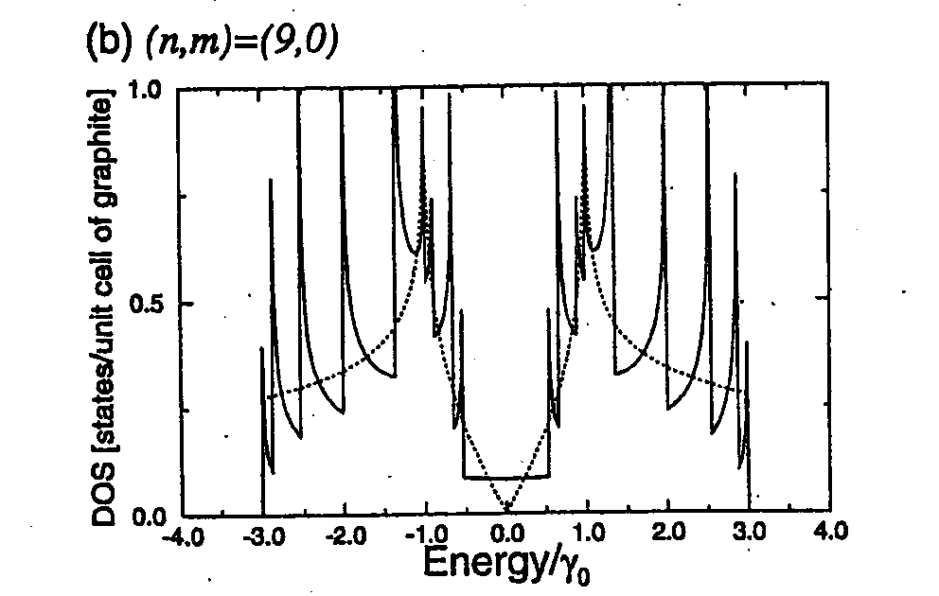
Electronic structure
radial breathing modes RBM
υ_{RBM} (cm⁻¹) = α/d (nm ) ;
223.75<α<248
transversal axial
Electronic 1D density of states for two (n,0) zig-zag nanotubes.Dotted line shows the density of states for the 2D graphene sheet
(R.Saito,M.S Dresselhaus et al J.Appl.Phys 73,494,(1993))
-longituginal

Slide 31
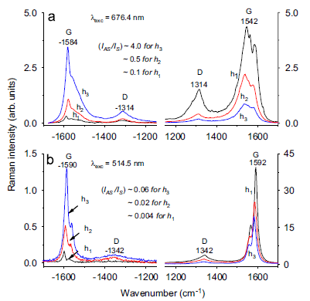
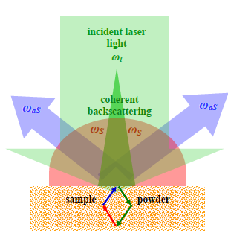
SERS spectra of mixture semiconductor (66%) and metallic (33%)
carbon nanotubes packed in bundles
Stokes and anti-Stokes SERS spectra
on SWNTs films of different thicknesses
(h₁<h₂<h₃, i.e about 30, 60 and 120nm )
recorded through a microscope objective
of x0.55 numerical aperture under
excitation wavelengths
of 676.4 and 514.5 nm.
The I_{aS}/I_{S} ratio was estimated for
the G band. Au as metallic SERS support
Explanation:
Single beam CARS effect
I.Baltog et al .Phys Rev B,72,(24), 245402,(2005) → SWCNTs
J. Raman Spectrosc,42,303,(2011) → conducting polymers
J. Appl. Phys., 110, 053106, (2011) → nonlinear optical materials

Slide 32
Abnormal anti-Stokes Raman scattering under resonant optical excitation
of SWNTs is a process reminiscent to a single beam CARS effect.
I_{CARS} ~ NA ω_{aS}²d² |χ(3)|² I²_{l}.I_{S} sinc2(|Δk|.d/2)
where : I_{l} - incident pump intensity;
χ⁽³⁾ - the dielectric susceptibility; d - slab thickness; Δk - the phase-mismatch requirement → (Δk = k_{as} – (2 k_{I}– k_{S}) ; k_{as}, k_{S} ,k_{I} are the wave vectors); NA is the numerical aperture of the
collecting lens.
a-Stokes
Stokes
weak temperature
dependence
Baltog et all. Journal of Optics A: Pure and Applied Optics 7, 1-8, (2005) ;
Phys Rev B,72,(24), 245402-245413,(2005) ;

Slide 33
B. Anti-Stokes and Stokes SERS spectra of single-walled
carbon nanotubes highly separated into semiconducting (99%) and metallic (98%) nanotube components.
B₁. Absorption spectra of semiconducting (99%) and metallic (98%) SWNT
514
676
Calculated Kataura plots of
van Hove singularities
Energy vs. tub diameter

Slide 34
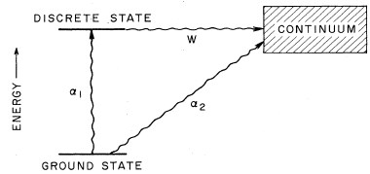
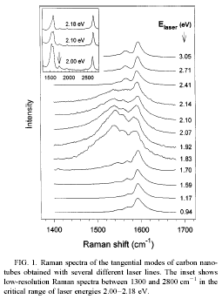
Fano asymmetry
Breit-Wigner-Fano (B WF) profile :
I=I₀{1+(ω₀ - ω)/ΔωΓ}²/{1+[(ω₀ - ω)/Δω]²}
Δω = line width ;
Γ = parametre of asymetery
●The quantum interference between two configurations in the transition process into a final state with the same energy:
one direct <2‌α₂|0> and one indirect via a discrete state <2‌W|1> <1‌α₁|0> , where W is a matrix element describing a nonradiative transition from discrete to continuum.
●The energy continuum of these transitions overlaps with the energy of the discrete Raman active optical phonon of the same symmetry and an interference between the phonon and the electronic transition takes place.
M.A.Pimenta, …,G.Dresselhaus, and M.S.Dresselhaus.., Phys.Rev.B 58,R16016-R16019,(1998)

Slide 35
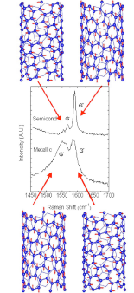
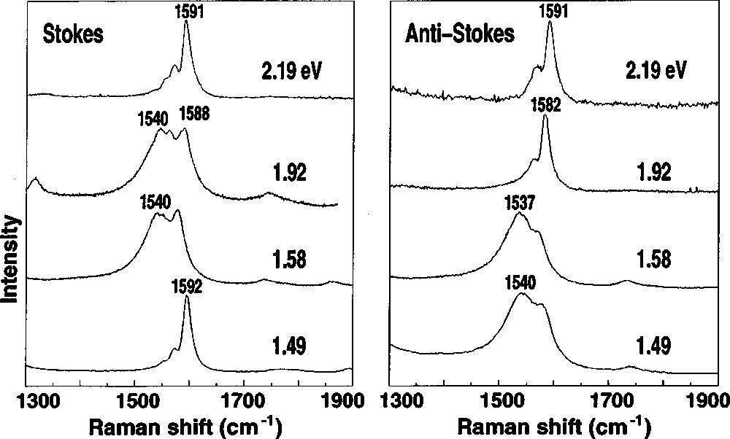
TO
LO
Stokes and anti-Stokes Raman spectra for SWNT’s of d~1.49 nm taken at four different values of E laser
LO
TO
S. D. M. Brown et al. Phys. Rev. B 61, R5137(2000)
Raman G⁺ and G⁻ peaks associated to LO and TO
phonons for semiconducting and metallic SWNTs
?
S. Piscanec et al. Phys. Rev. B 75, 035427(2007)

Slide 36


• Since metals are infinitely polarizable, it is hard to see how a vibration of the atoms
in the crystal lattice could cause a change in the polarizability.
Raman activity of metals may be generated by small clusters of metal atoms, and in
the case of metallic nanotubes by their association in bundles
 Fano Raman profile
The relative BWF intensity is always weak for thin
bundles or individual tubes but varies for thicker
bundles. The solid lines show estimated relative intensities
for pure metallic bundles and bundles containing isolated
or noninteracting metallic tubes.
K.Kempa et al. Phys Rev B 66, 161404 (2002);
66, 195406 (2002)

Slide 37
G Raman band profiles of metallic ( 98%) and semiconductor (99%)
carbon nanotubes
Supports: −− glass ; −− Au; −− Ag
Anti-Stokes (a₁;b₁) and Stokes (a₂;b₂) G Raman band profiles of metallic (~98% pure, a₁;a₂) and semiconductor (~99% pure, b₁;b₂) SWNTS deposited in a thin layer on glass (black), Au (red) and Ag (blue) supports. All spectra were recorded in a backscattering geometry with 2 mW of laser intensity focused on the sample through a 50x objective.

Slide 38
SERS evidence of anomalous behavior in anti-Stokes Raman branch
of metallic nanotubes.
Stimulated
Raman
Scattering
effect
CARS effect
Intensities of the anti-Stokes and Stokes G Raman lines (1595 cm⁻¹) under 514.5; 647.1 and 676.4 nm excitation light (normalized by the intensity obtained from samples with the glass substrate) for metallic (M, ~98 % pure) and semiconductor (S, ~99% pure) C-SWNT thin films deposited on glass, Au and Ag supports. The intensity of the laser light focused on all samples was 2 mW.

Slide 39
Supports:
−− glass
−− Au
−− Ag
MWNT
LAUSANNE
Metallic
MWNT
ALDRICH
Metallic +
Semiconductor

Slide 40
Insulator, semiconductor and metal
Clasification based on bandstructure
Conduction
band
E_{F}
Conduction
band
E_{g}
Vibration
levels
Energy
Valence
band
METAL
INSULATOR or
SEMICONDUCTOR

Slide 41
Absorption: Semiconductors
• Absorption by electron transition occurs if hν > E_{gap}
Energy of electron
unfilled states
incident photon energy hν
E_{gap}
typical resonance
I
o
filled states

Slide 42
Optical Properties of Metals: Absorption
• Absorption of photons by electron transition:
Energy of electron
unfilled states
Incident photon
hν
ΔE = hν required covers a large
spectral range ; no typical
resonance
I
o
of energy
filled states
• Metals have a fine succession of energy states that causes absorption and reflection;
• Normally, the Raman activity is conditioned of the vibrations which change the
poalarizability of the molecule or material.
• Because the visible light cannot penetrate the metals , Raman scattering results from
the modulation of the electronic susceptibility by the optical vibration modes within
the skin depth by the optical vibration modes .
• Inside the medium, the amplitude of the electric field decays to zero rapidly with
distance.

Slide 43
Variation with excitation laser intensity and temperature of the anti-Stokes
Raman G band of semiconductor and metallic carbon nanotubes
Typical non-linear
dependence for
a non-linear optical process
SRS
Intensities of Stokes (filled symbols) and anti-Stokes (open symbols) Raman lines at 1595 cm⁻¹ (G band) measured in a backscattering geometry for semiconducting (~99% pure; up triangles) and metallic (~98% pure; down triangles) of C-SWNTs under 676.4 nm excitation light focused through a 50x microscope objective. The samples were in the form of thin films layered on a glass (triangles) substrate or Ag SERS supports (stars). The Raman intensity was normalized to the signal measured at the lowest excitation intensity (0.2 mW).
Variation with temperature of the I_{aS}/I_{S} ratio associated with the Raman G band (1590 cm-¹) for semiconducting (~99% pure, red symbols) and metallic (~98% pure, blue symbols) of C-SWNTs deposited on a glass substrate. All data were obtained at λ_{exc} = 676.4 nm with 2 mW of laser power focused on the sample through a 50x microscope objective. The green line illustrates the variation allowed by applying the Boltzmann law to the recorded Stokes Raman spectra for metallic tubes.

Slide 44
Polarized Raman spectra of isolated
semiconducting and metallic nanotubes
Anti-Stokes Raman intensity of the Raman G band for semiconductor (~99% pure; a) and metallic (~98% pure; b) SWNTs on a Ag support versus the intensity of excitation laser light. All data were obtained at λ_{exc} = 676.4 nm with light polarized along (LO) and perpendicular (TO) to the tubes’ axes.
Anti-Stokes and Stokes Raman spectra for semiconductor (~99% pure; S1,S2; black curve) and metallic (~98% pure; M1,M2; red curve) C-SWNTs excited at λ_{exc} = 676.4 nm with light polarized along (LO) and perpendicular (TO) to the tubes’ axes.

Slide 45
Conclusion:
i) SERS effect manifests differently under non-resonant and resonant optical excitations, it
results from the coupling of plasmons associated with the incident light with the plasmons
associated with the Stokes and anti-Stokes spontaneous Raman emissions.
ii) Under non-resonant and resonant optical excitation SERS manifests as stimulated Raman
process and CARS effect, respectively.
iii) Contrary to the results reported so far , and regardless of whether the optical excitation was
non-resonant or resonant and regardless of whether glass, Au or Ag was used as the substrate,
the metallic single wall carbon nanotubes (SWNTs) do not show an anomalous anti-Stokes
Raman emission.
iv) Semiconducting SWNTs always show an anomalous anti-Stokes Raman emission that grows
further under increases in the excitation light intensity or temperature.
v) Semiconducting SWNTs behave differently than metallic SWNTs because of the splitting
of electronic levels into a vibration structure, which under resonant optical excitation
changes the polarizability of the material by overpopulating the states and contributes
to an enhancement of the anti-Stokes Raman emission;
vi) Metallic SWNTs (like any metal) are infinitely polarizable at very short distances, fact
which determines the invariance of the Stokes Raman spectrum under changes of
the polarization of the excitation light

Slide 46
Own contributions:
Appl Phys Lett 66,1187-1190,(1995) J Opt Soc Am B 13, 656-660, (1996)
Pure Appl. Opt. 5 , 645–653,(1996) J. Raman Spectrosc. 29, 825È832 (1998)
Phys Rev B 65, 235401,(2002) Carbon, 40,2201-2211,(2002)
J. Opt. A: Pure Appl. Opt. 7,632–639,(2005) Phys. Rev. B,72,(24), 245402-245413,(2005)
Carbon, 43,1-9,(2005) J Raman Spectrosc 36,676-698, (2005)
Physica E: 40(7),2380,(2008) J. Phys:Condensed Matter. 20,(27), 275215, (2008)
Physica status solidi (b) 245, (10), 2221, (2008) Carbon ,47, (5),1389-1398,(2009)
Synthetic Metals 159 , 2173,(2009) J Raman Spectrosc ,42,(3),303, (2011 )
J. Phys. B: At. Mol. Opt. Phys. 44,095401, (2011) Optical materials, 33, (9), 1410,(2011)
J Appl Phy, 110, 053106, (2011) Proc. Romanian Acad., Series A, 13, (2), 109–117, (2012)
J Phys Chem. C, 116, 25537−25545, (2012) Optics Communication : submitted, (2013)
J Raman Spectrosc, submitted, 2013 Journal of Optics : submitted, (2013)

Slide 47
WEB of Science
2000-2012
9,089 records. Topic = (Raman carbon nanotubes)
Use the checkboxes below to view the records. You can choose to view those selected records, or you can exclude them (and view the others).
 | Field: Authors | Record Count | % of 8993 | Bar Chart | Data rows displayed in table All data rows
1 | DRESSELHAUS MS | 236 | 2.624 %
2 | SAITO R | 146 | 1.623 %
3 | JORIO A | 127 | 1.412 %
4 | DRESSELHAUS G | 122 | 1.357 %
5 | KATAURA H | 117 | 1.301 %
6 | KUZMANY H | 113 | 1.257 %
7 | LEFRANT S | 94 | 1.045 %
8 | PIMENTA MA | 94 | 1.045 %
9 | THOMSEN C | 94 | 1.045 %
10 | IIJIMA S | 76 | 0.845 %
11 | KAVAN L | 75 | 0.834 %
12 | ROTH S | 74 | 0.823 %
13 | SOUZA AG | 71 | 0.790 %
14 | ENDO M | 69 | 0.767 %
15 | PICHLER T | 68 | 0.756 %
16 | BAIBARAC M | 65 | 0.723 %
17 | BALTOG I | 65 | 0.723 %
18 | DUNSCH L | 64 | 0.712 %
19 | SAUVAJOL JL | 64 | 0.712 %
20 | KIM YA | 61 | 0.678 %

Slide 48
Thanks for your attention

Slide 49
Carbon allotropic particles
Graphite
Graphene
metallic
semiconductor
Diamond
Multi-wall carbon
nanotubes
Single wall carbon nanotubes
metallic
Fullerene : C₆₀

Slide 50
What is the wavelength of the surface plasmon ?
let us find k:
substitute
k_{x}
The surface plasmone mode always lies beyond the light line, that is it has greater momentum than a free photon of the same frequency ω
ω
light cone ω = c k
k

