Slide 1
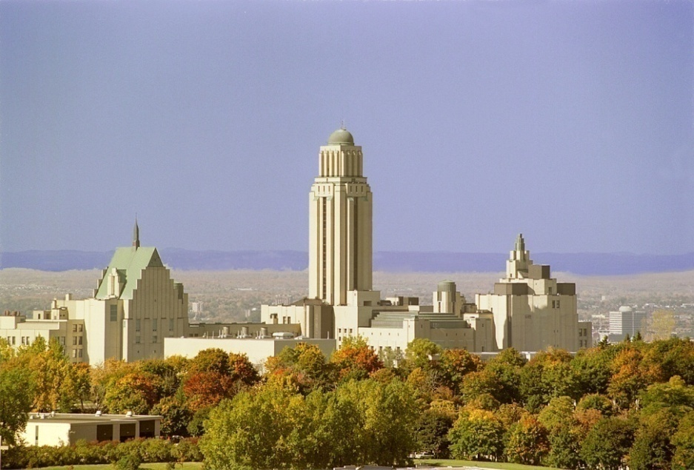
Université de Montréal
Première Université au Québec
L’UdeM forme avec ses écoles affiliées, HEC Montréal et l’École Polytechnique, le premier pôle d’enseignement et de recherche du Québec.
L'Université en nombres (données 2009) :
  Budget annuel : 900 millions €
  Nombre d'étudiants : 58 445 dont 14 281 aux études supérieures (M.Sc. et Ph.D.)
  Diplômation : 1er cycle (B. Sc.) 6 623
  2ième cycle (M. Sc.) 3 470
  3ième cycle (Ph. D.) 421

Slide 2
Turning basic research results into applications
Michel Moisan
Groupe de physique des plasmas
Université de Montréal

Slide 3
Outline
Basic research
  Plasma sources produced by RF and microwave fields
Industrial applications
Abatement of perfluorinated compounds (PFCs)
Plasma sterilization of medical devices (MDs)
Additional comments
Patents
Notes:
plasma sources... both the technology and their modelling
abatement... commercialize by Air Liquide; sterilization... well advance looking for partner

Slide 4
RF and microwave plasma sources
Plasma: free moving electrons & ions
  a collective medium
  macroscopically neutral (Debye sphere)
    Example: sun
Ionized gas: electrons, ions
and electrically neutral atoms (molecules)
    Example: fluorescent tube
Notes:
1 eV and 10¹⁰ cubic centimeters: Debye length 0.07 mm

Slide 5
RF and microwave plasma sources
(outline)
Plasma sources in general
  Electrical discharges
    DC discharges
    RF and microwave (HF) discharges :
      (RF ≈ 1 - 200 MHz, MW: 200MHz - 300 GHz)
    → Surface wave discharges (SWDs)
  Modelling of HF discharges
  Equivalent circuit model of HF discharges
    → Impedance matching
Notes:
Outline of this section (1 out of 3 sections)

Slide 6
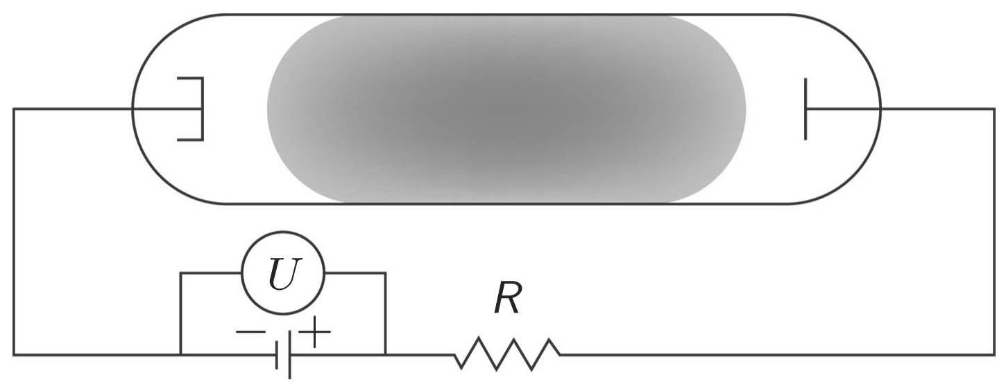
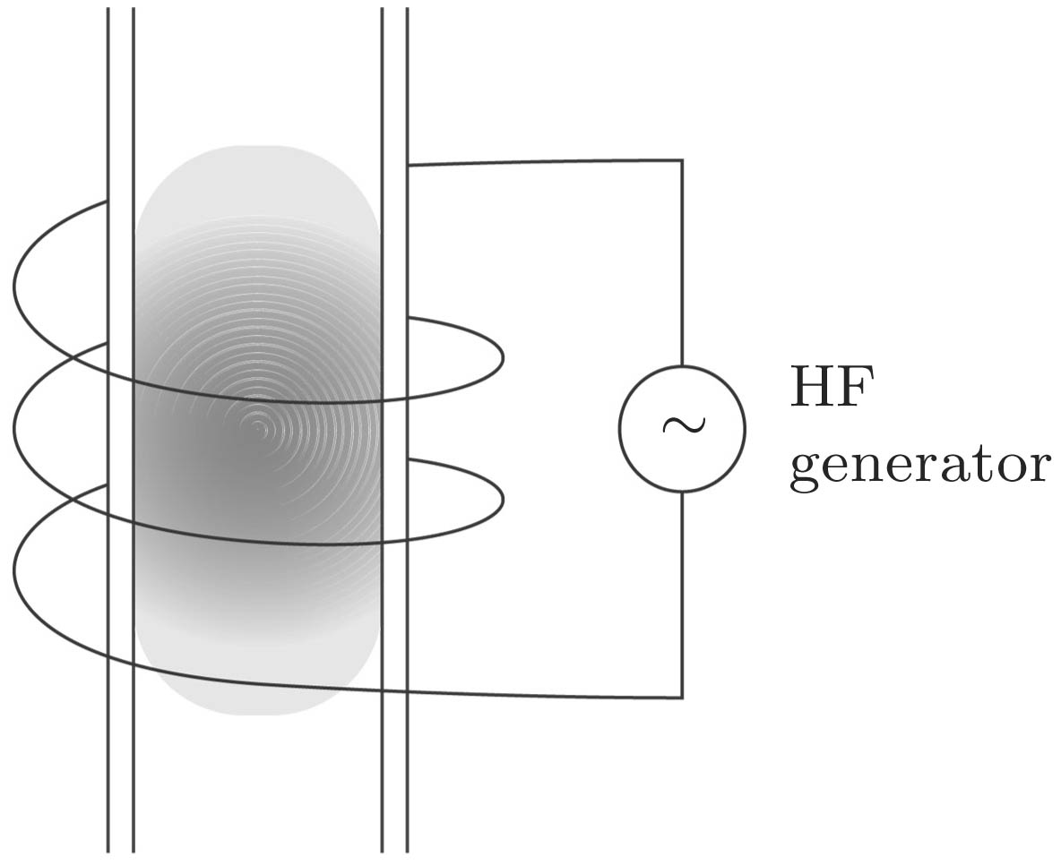
RF and microwave plasma sources
Electrical discharges
  DC discharges
  High frequency (HF) discharges
Schematic of a tubular DC discharge
Electrodeless discharge

Slide 7
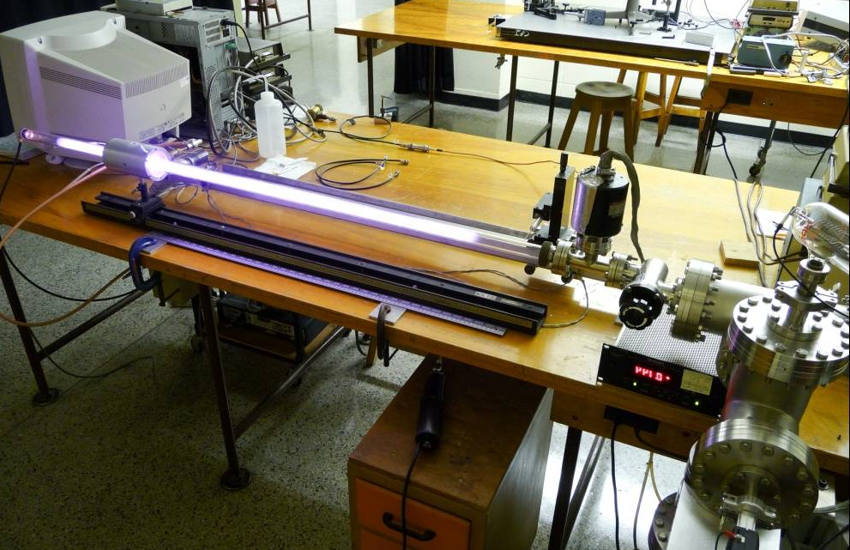
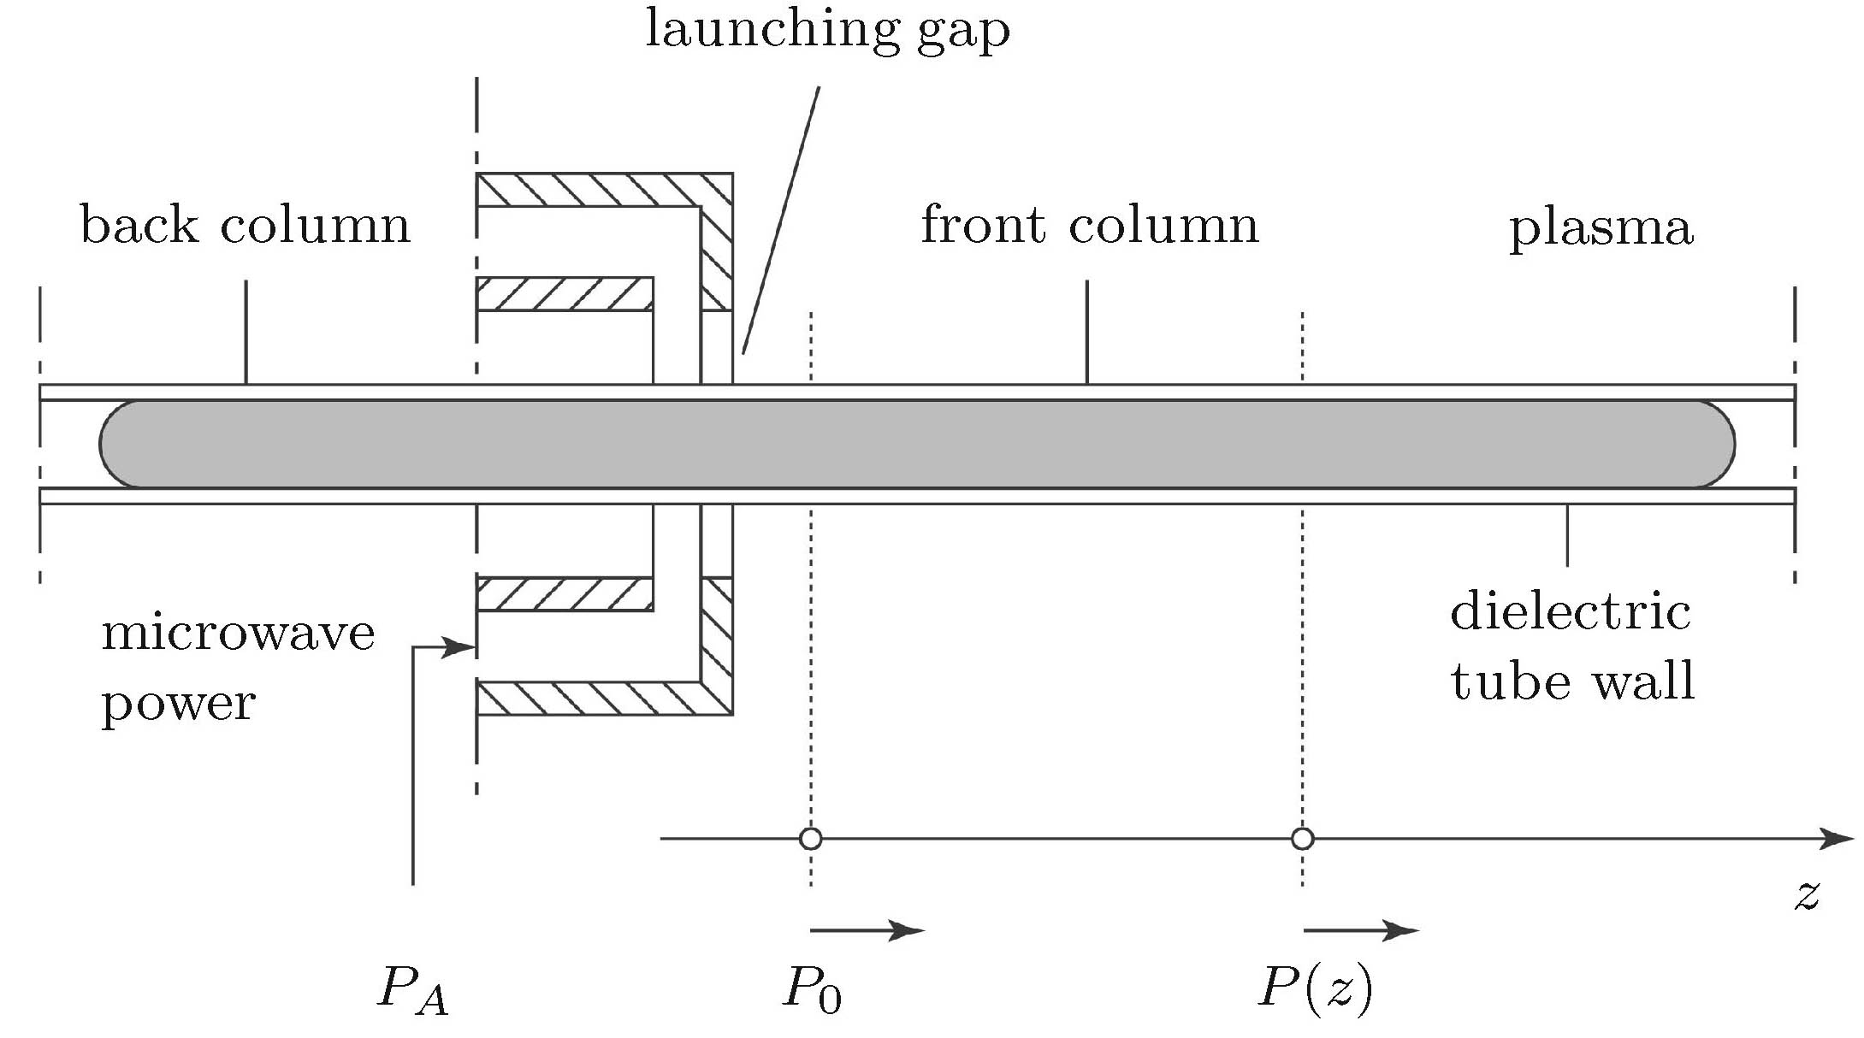
HF plasma sources
A particular class of HF discharges
  Surface-wave discharges (SWDs)
Argon, 50 mtorr, 40 W
Total length 1.05 m

Slide 8
HF plasma sources
Parametric domain of SWDs
Tube diameter: 1 mm to at least 350 mm
Operating frequency: 200 kHz to at least 40 GHz
Gas pressure (any kind of gas): 0.5 mtorr to at least 10 times atmospheric
→ Main "application" of SWDs: basic research
parametric study of HF plasmas

Slide 9
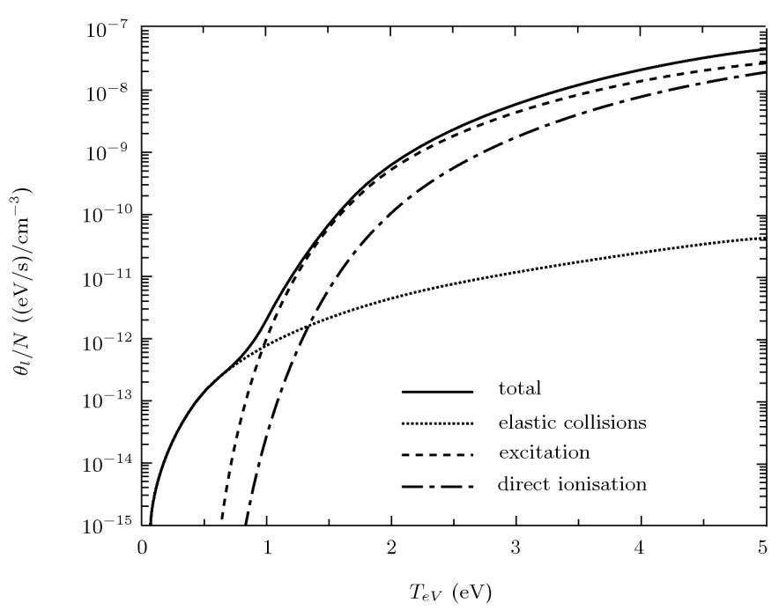
Modelling HF plasmas
A novel parameter to describe HF discharges:
power absorbed per electron
Power taken from the HF field by
electrons and tranferred to heavy particles
→ under steady state:

Slide 10
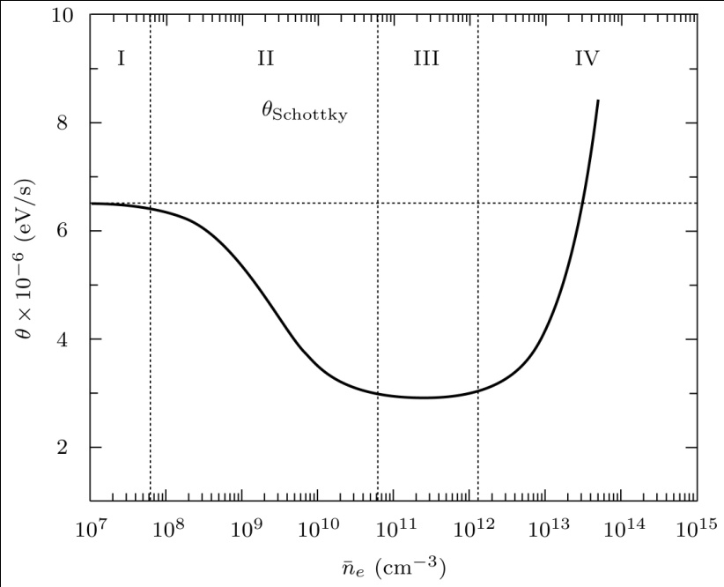
Modelling HF plasmas
Similarity law
Variation of θ as a function
of electron density
For given operating conditions (gas nature & pressure, frequency,
vessel dimensions) and absorbed power density (P_{a}/V), whatever their field applicators, HF discharges share the same properties

Slide 11
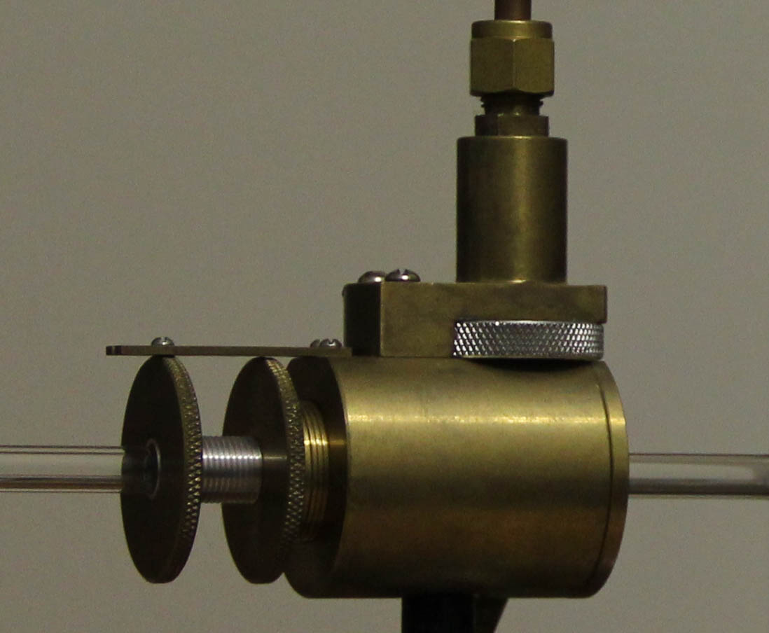
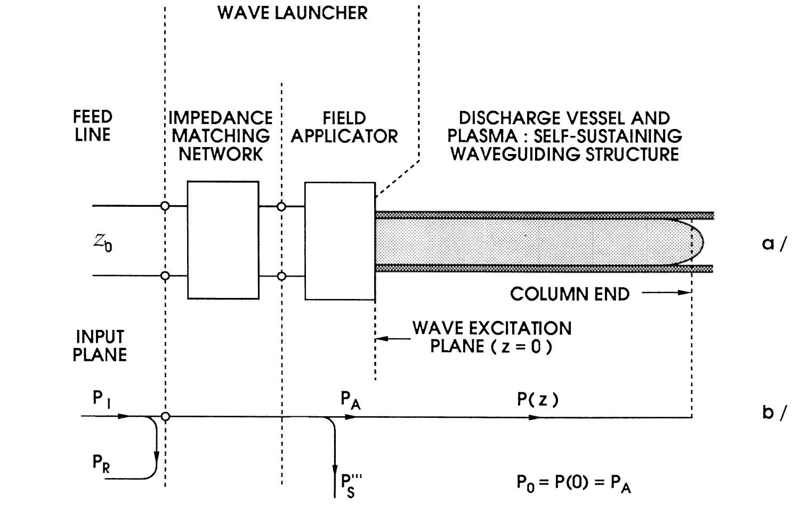
HF plasma sources
Wave-launcher: surfatron
HF plasma source (schematic)

Slide 12
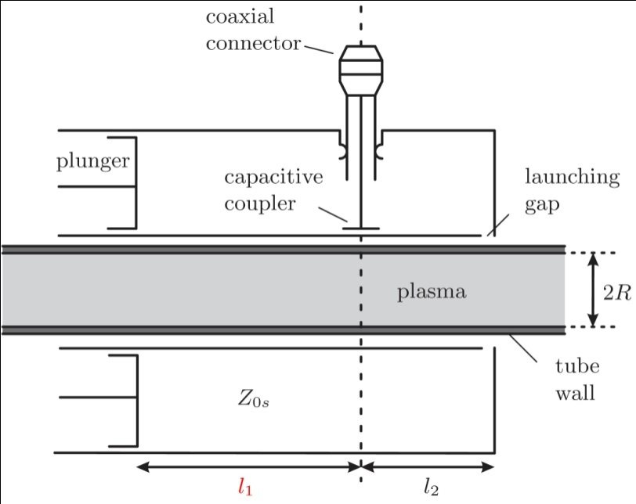
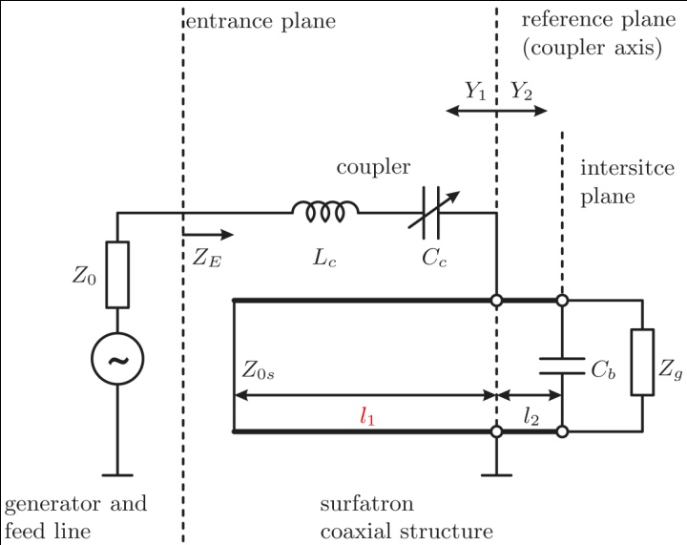
HF plasma sources
Surfatron: equivalent circuit
Transmission line analysis of the surfatron

Slide 13

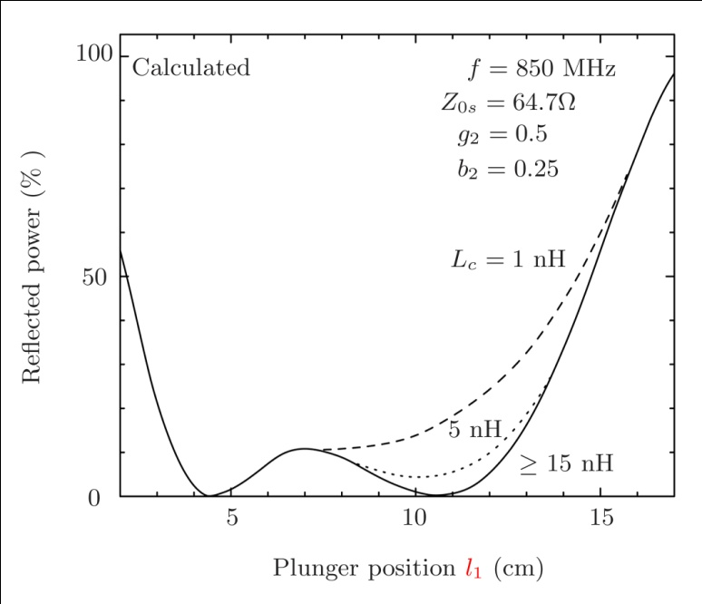
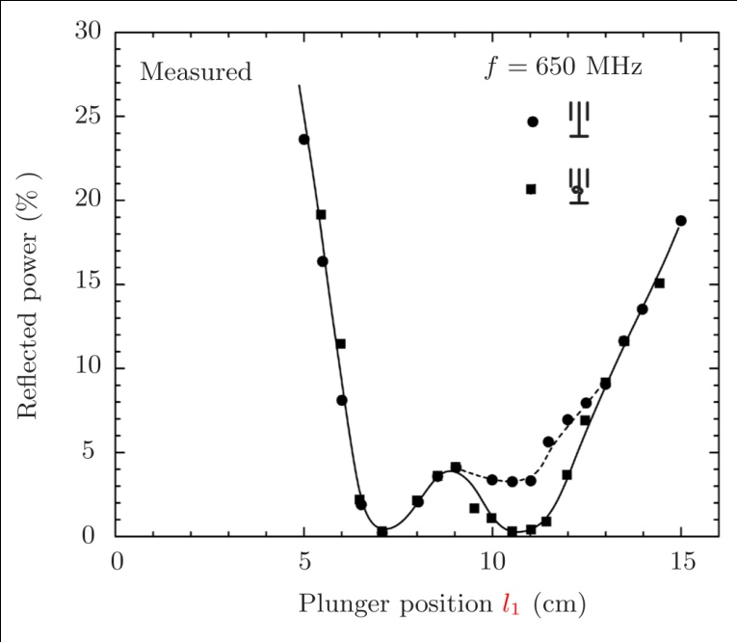
HF plasma sources
Impedance matching

Slide 14
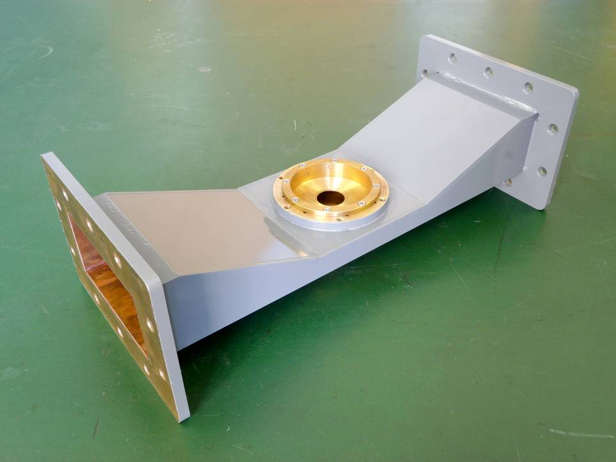
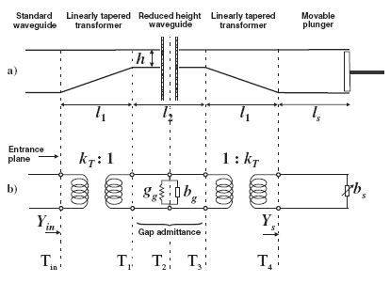
HF plasma sources
Wave-launcher: surfaguide (≥ 1GHz)

Slide 15
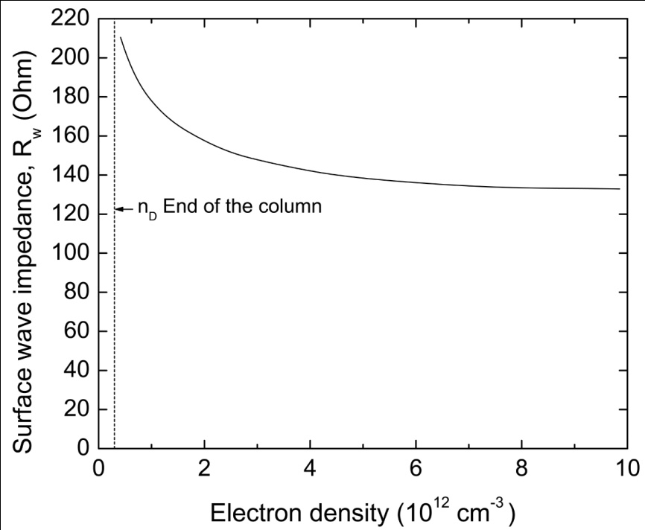
HF plasma sources
SW plasma column acts as a transmission line: calculated characteristic impedance value Z_{p} ≈ 140-160 Ω.
Reduced-height characteristic impedance of launcher: Z’₀ = 186 Ω
ohm

Slide 16
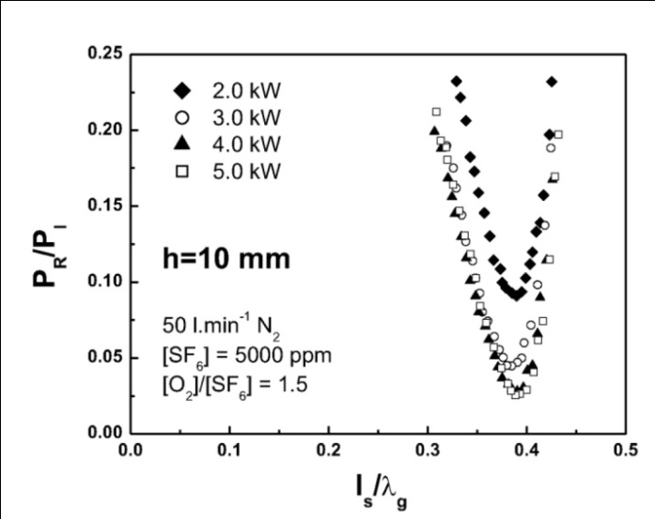
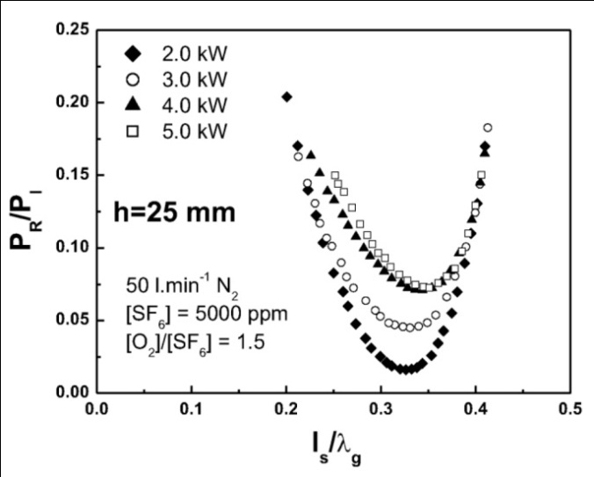
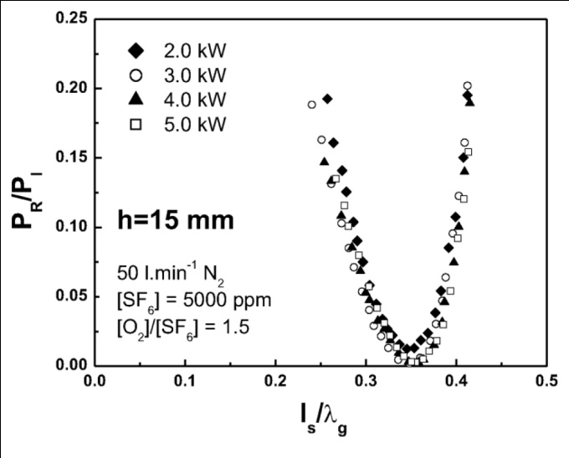
HF plasma sources
Optimizing the surfaguide plasma source
Fixed plunger: no need for retuning

Slide 17
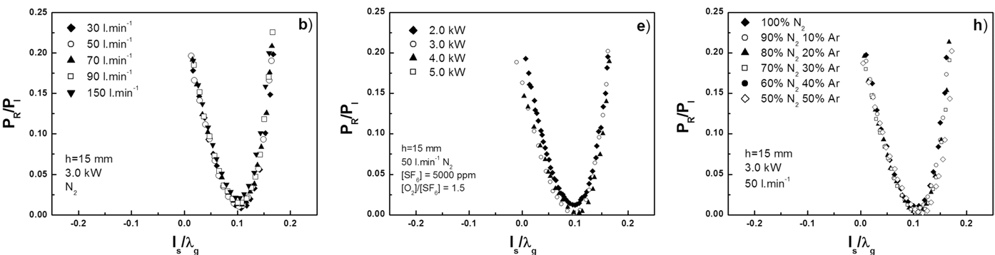
HF plasma sources
h = 15mm
Fixed plunger: no need for retuning

Slide 18
Outline
Basic research
  Plasma sources produced by RF and microwave fields
Industrial applications
Abatement of perfluorinated compounds (PFCs)
Plasma sterilization of medical devices (MDs)
Additional comments
Patents
Notes:
plasma sources... both the technology and their modelling
abatement... commercialize by Air Liquide; sterilization... well advance looking for partner

Slide 19
Abatement of PFCs
Gas | lifetime (year) | GWP (100 year)
CO₂ | 120 | 1
SF₆ | 3200 | 9000
CF₄ | 50 000 | 6300
PFCs contribute to the greenhouse
effect and related climate changes
Motivation
  Abatement of undissociated SF₆/CF₄ in etch tools
  Microwave plasma at atmospheric pressure (post-pump solution)
    benefits: transparent to process tool and pump/multiple chamber exhaust treatment/rugged microwave technology
    technical challenges: atmospheric pressure operation in N₂ (20 to 120 slm) with 0.1-1% PFCs
Decisive advantages of plasma solution vs combustion
  Higher destruction rates with lower energy consumption
  Selective chemistry, easily scrubbable byproducts
  Electrical system, no combustible gas feedstock, safe process
  Reduced utility requirements, lower operating cost
Notes:
scrubber: to clean (remove chemical byproducts in a safe way)

Slide 20
Abatement of PFCs
Non-thermal chemistry
  T_{e} (0.9 -1.5 eV) » T_{gas} (1000 - 5000 K)
A two-step process
PFC + e ⇒ R + P (molecule dissociation)
R + O , P + O ⇒ fragment oxidation leading to final by-products
(no reversibility)
Trapping of acid-like residues on scrubber
Humidified soda lime or similar alkaline bed
No hazardous byproducts at exhaust

Slide 21
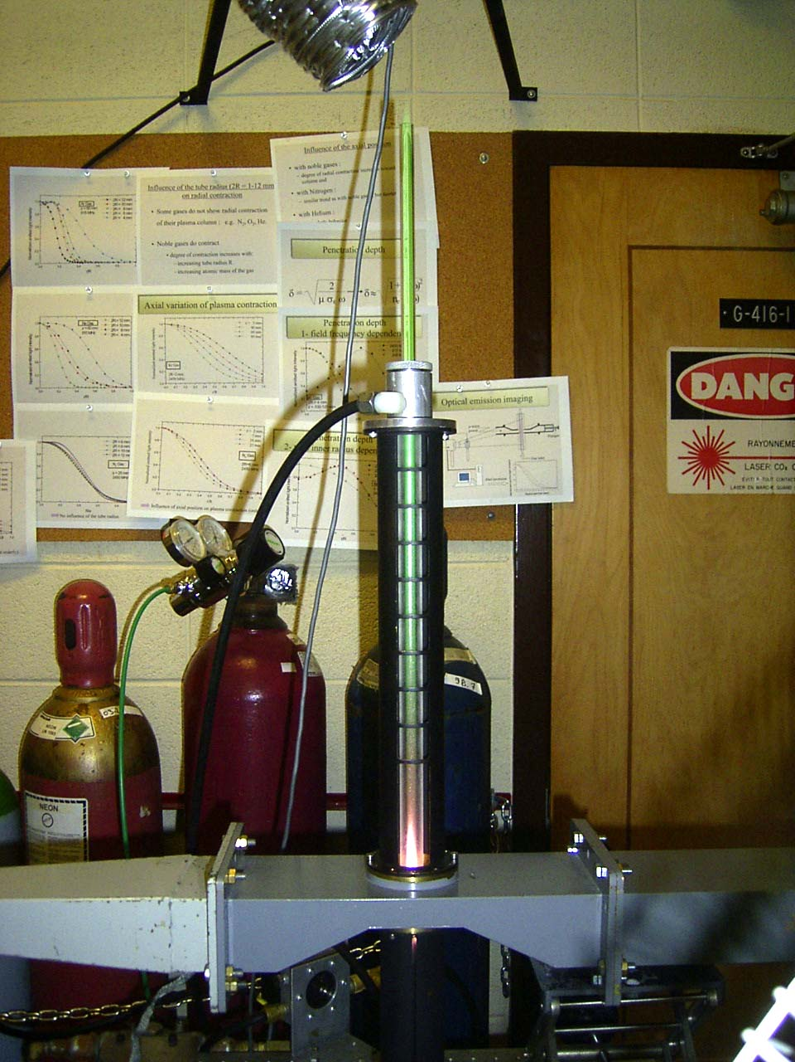
Abatement of PFCs
Experimental setup
➊ Discharge tube
AlN high refractory ceramic
➊
➋ Plunger for impedance
matching
➌ SW plasma
➍ Surface-wave field applicator
''Surfaguide''
WR-340 standard waveguide
➎ µW feed-line
➌
➍
➋
➎
h

Slide 22
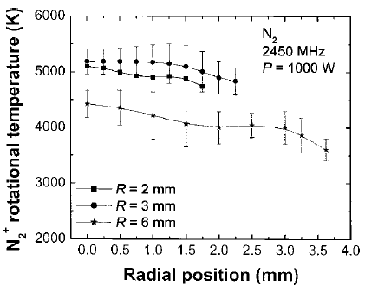
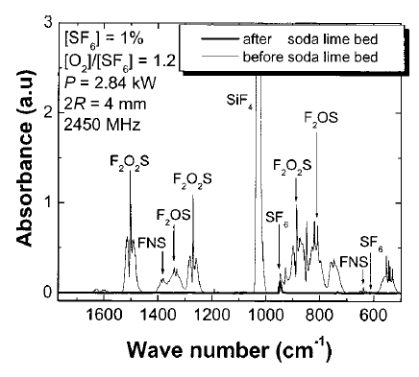
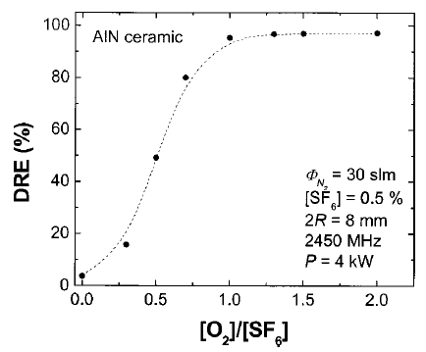
Abatement of PFCs
SF₆ in N₂/O₂ mixture as a working example
DRE: destruction & removal efficiency

Slide 23
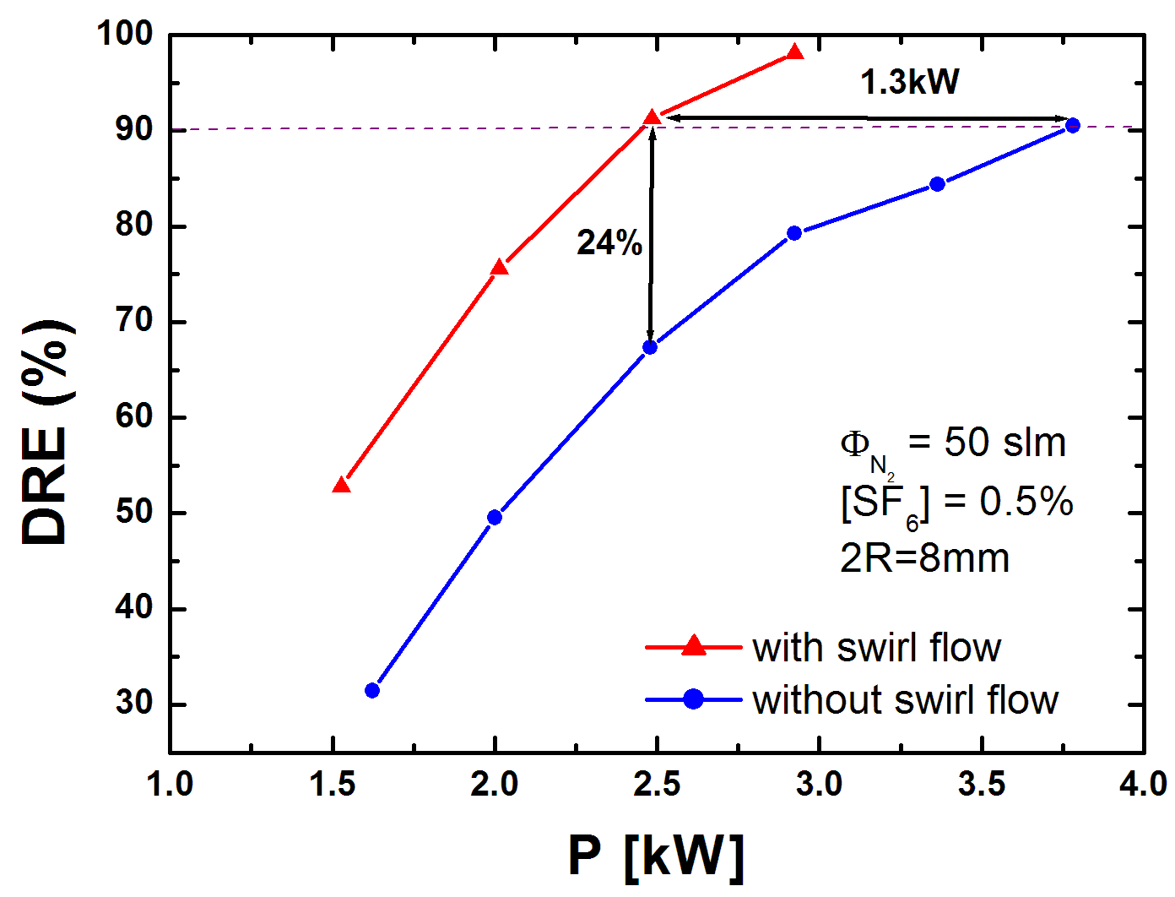
Abatement of PFCs
Improving process efficiency and time-up
  Swirl-type flow (vortex)
Prevents plasma from licking and breaking discharge tube

Slide 24
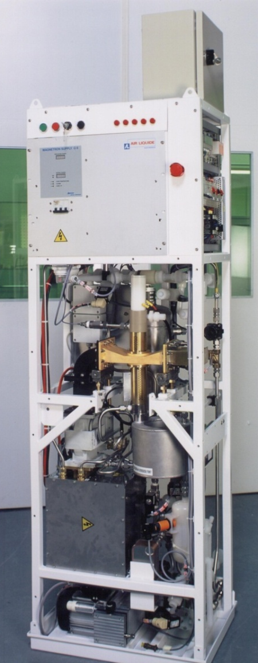
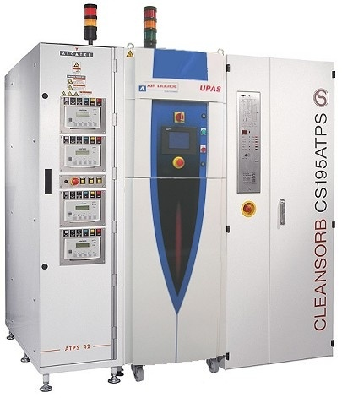
Abatement of PFCs

Slide 25
Outline
Basic research
  Plasma sources produced by RF and microwave fields
Industrial applications
Abatement of perfluorinated compounds (PFCs)
Plasma sterilization of medical devices (MDs)
Additional comments
Patents
Notes:
plasma sources... both the technology and their modelling
abatement... commercialize by Air Liquide; sterilization... well advance looking for partner

Slide 26
Plasma sterilization of medical devices (MDs)
"Cold plasma" sterilization: can be low-temperature and dry (≠ autoclave)
non-polluting, non-toxic and no ventilation required (≠ ethylene oxide)
Possible operating conditions
Direct or indirect exposure of MDs to plasma species
  Direct contact with the discharge plasma
  Remote plasma (flowing afterglow)
Inactivation rate much faster when MDs in direct contact (few seconds to few minutes for a 4-6 log decrease) than in the afterglow (30 to 60 min)
Reduced pressure (typically below 5 torr) or atmospheric pressure operation:
  Reduced pressure. More uniform plasma (diffusion), lower gas temperature than at atmospheric pressure
  Atmospheric pressure. Higher inactivation rate.

Slide 27
Plasma sterilization
Nature of the biocidal agents provided by plasma and their mode of action
Biocidal agents
chemically reactive radicals (e.g. O, OH) and energetic ions
  More or less severe (structural) damage to vital metabolic functions of microorganisms (e.g. through chemical erosion)
UV photons
  Irreversible lesions to the genetic material (DNA, RNA), little apparent damage to the morphology of the bacterial spores

Slide 28
Plasma sterilization
Bacterial endospores as bio-indicators
Most resistant type of microorganisms : comprised of double-helix DNA, surrounded by protecting coats
Characteristics of our sterilizer
Minimum damage to MDs: subjected to UV photons, spore morphology externally unaffected. Less damage to MDs than with chemical agents and/or ion bombardment
Important issues to be assessed:
  ability of UV photons to achieve inactivation of microorganisms even in presence of bioburden
  denaturation of infectious proteins and toxins
Biocidal agent(s) uniformly distributed within sterilizer chamber:
pressures typically less than 5-10 torr to benefit from diffusion

Slide 29
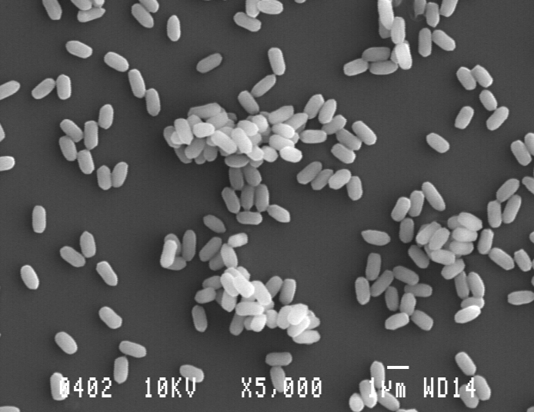
Plasma sterilization
Bio-burden
"Clean" spores
Microorganisms embedded in a bio-product, e.g., coagulated blood:
reduces (delays) access of biocidal agents

Slide 30
Plasma sterilization
UV radiation in the N₂-O₂ flowing afterglow : characteristics and biocidal efficiency
Outflow from discharge : flowing afterglow

Slide 31
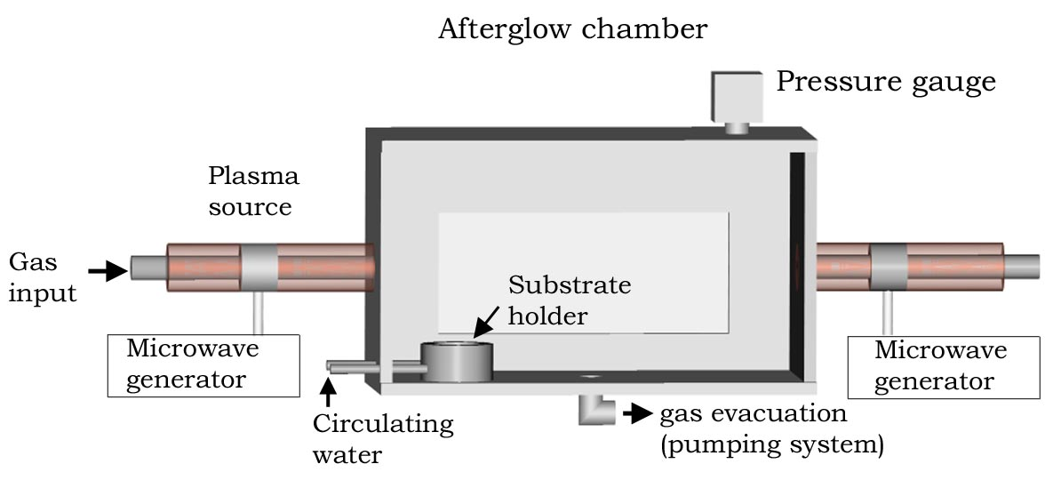
Plasma sterilization
N₂-O₂ discharge flowing-afterglow system : a remote-plasma sterilizer
50 L flowing-afterglow plasma sterilizer. N₂ gas flow :1 standard L/min, gas pressure in the chamber set at 2 or 5 torr. Plasma sustained either at 915 MHz or 2450 MHz by a surfatron

Slide 32
Plasma sterilization
Shape of survival curves
Bi-phasic survival curve. Decimal time D₂ »D₁.
B. atrophaeus spores exposed to the discharge afterglow from a N₂-0.3% O₂ gas mixture (O₂ percentage for maximum UV intensity) at 5 torr under a 2 slm total flow.
Total microwave power 500 W (50 L), 915 MHz.
Dotted lines are best fit to the data and the error bars are standard deviations
D₂ = 16 min

Slide 33
Plasma sterilization
Spore stacking and UV access
Schematized representation of: (a) an isolated spore with its genetic material (DNA) surrounded by various protecting coats and membranes (white part of the "box"); (b), (c) and (d) possible spore assemblies.

Slide 34
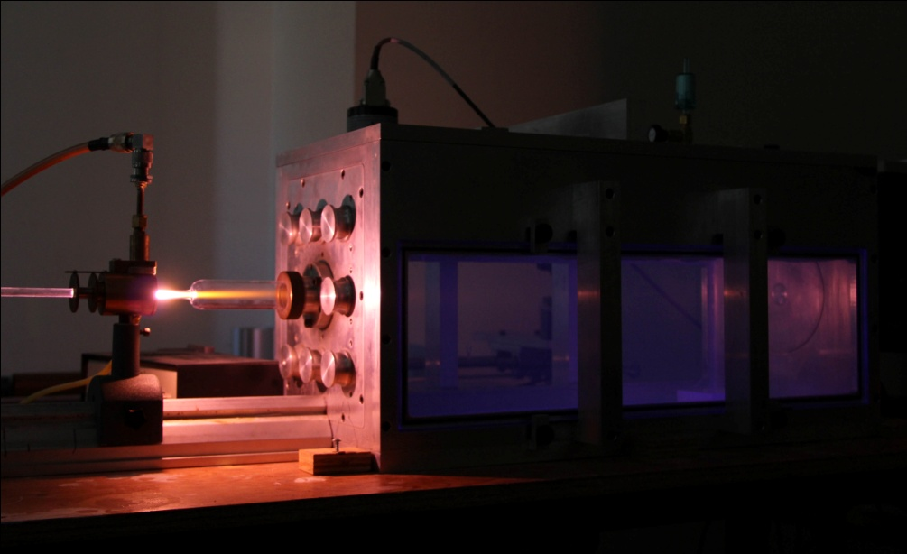
Plasma sterilization

Slide 35
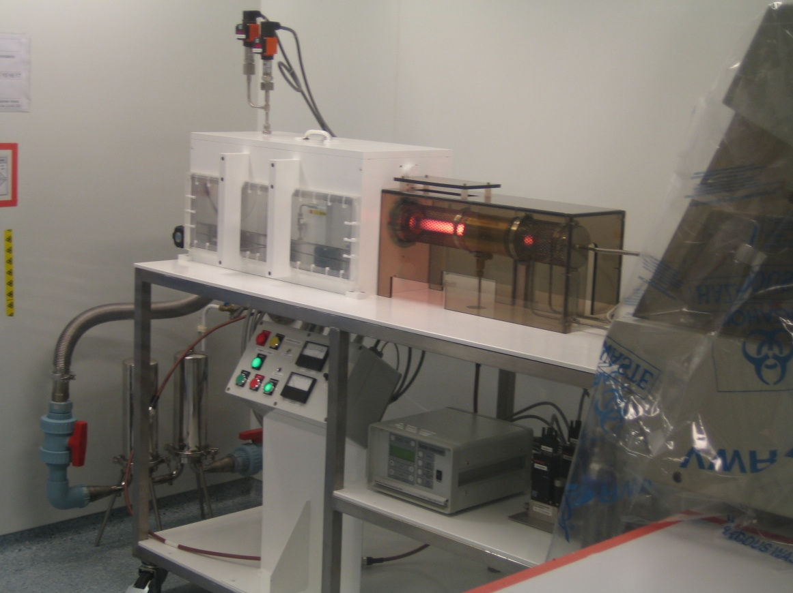


Plasma sterilization
Plasma post discharge treatments on inactivation of PrPsc
  Infectious prion in bovin brain extracts 10% (w/v) adsorbed on polystyrene or polypropylene → ELISA

Slide 36
Outline
Basic research
  Plasma sources produced by RF and microwave fields
Industrial applications
Abatement of perfluorinated compounds (PFCs)
Plasma sterilization of medical devices (MDs)
Additional comments
Patents
Notes:
plasma sources... both the technology and their modelling
abatement... commercialize by Air Liquide; sterilization... well advance looking for partner

Slide 37
Additional comments
Patent
A grant made by a government that confers upon the creator of an invention the sole right to make, use, and sell that invention for a set period of time.
PCT
The patent cooperation treaty (PCT) allows the applicant to file one single international application (in one prescribed language), who will then be able to file additional applications in about 140 countries at a later stage (around 30 months after the filing date).
The PCT searching authorities will provide a search report to the applicant before the publication of the application, allowing the applicant to either continue the process or withdraw the application depending on the outcome of the search report.
The PCT allows the applicant to defer the costs of translation and prosecution in each designated country but does not provide an international patent

Slide 38
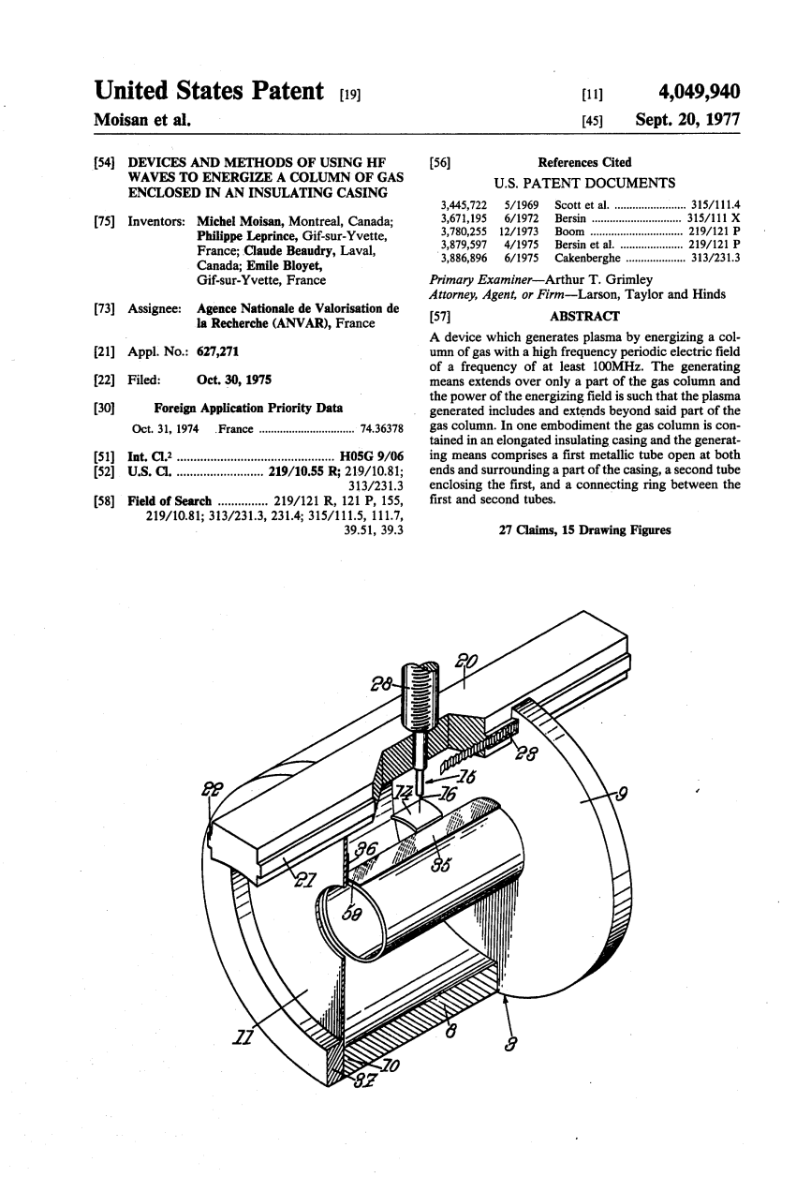
Additional comments

Slide 39
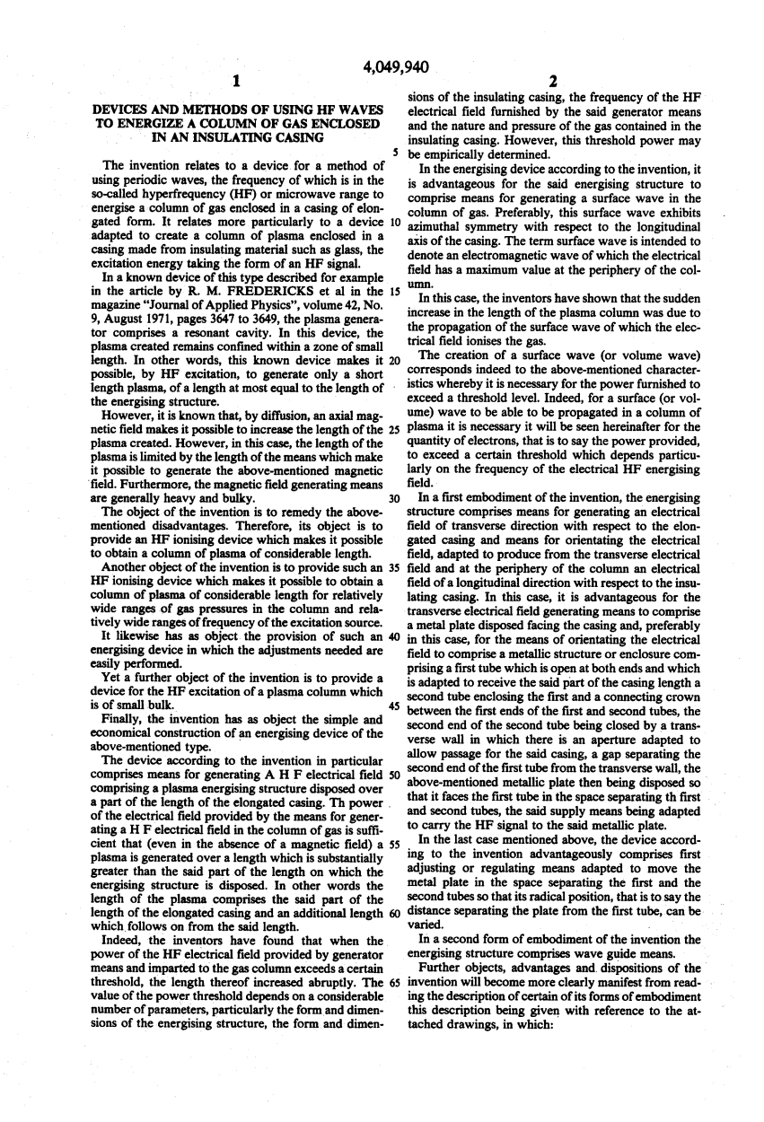
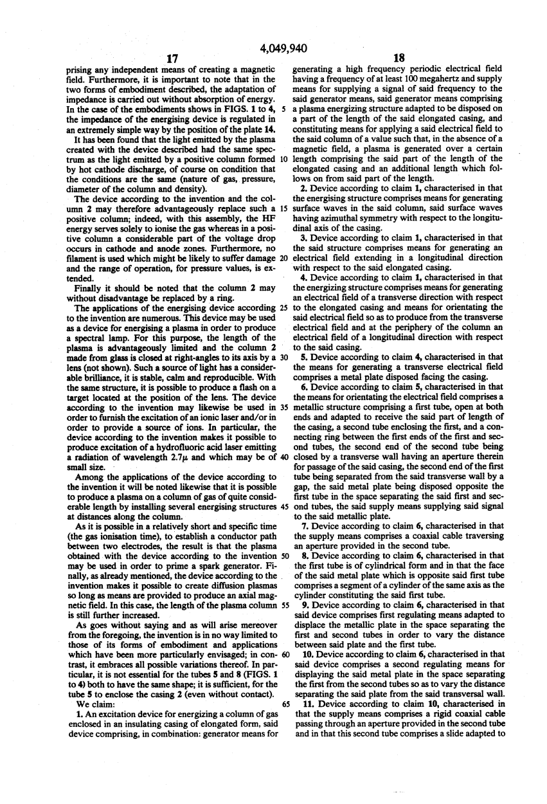
Additional comments

Slide 40
Thank you for your attention
To obtain reprints : michel.moisan@umontreal.ca

