Slide 1
Ziua IFA 2013
Programul Romania – CERN
17.12.2013

Slide 2
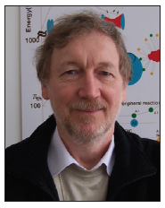
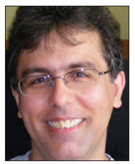
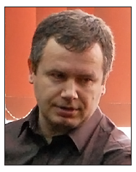
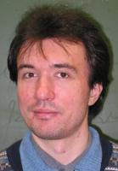
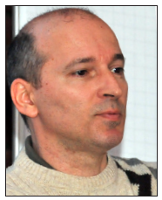
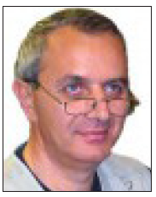
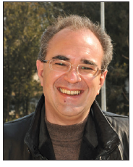
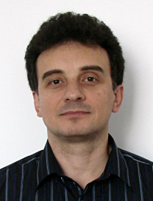
Realizari proiecte RO@CERN
ALICE-IFIN
Dr. Mihai Petrovici
ALICE-ISS
Dr. Daniel Felea
ATLAS
Dr. Calin Alexa
LHCb
Dr. Florin Maciuc
CONDEGRID
Dr. Mihnea Dulea
DIRAC
Dr. Mircea Pentia
ISOLDE
Dr. Nicolae Marginean
n_TOF
Dr. Tudor Glodariu

Slide 3
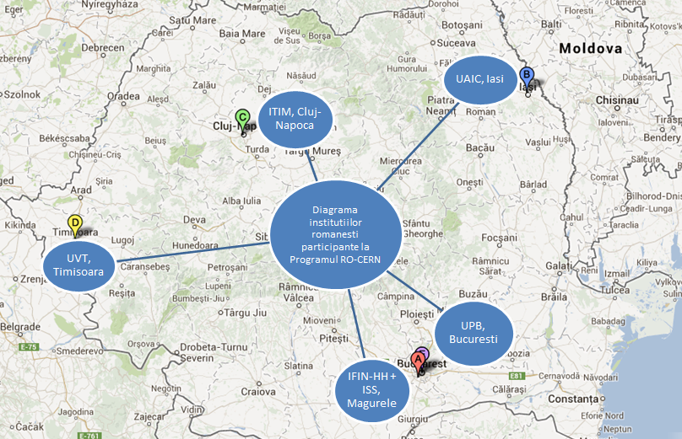
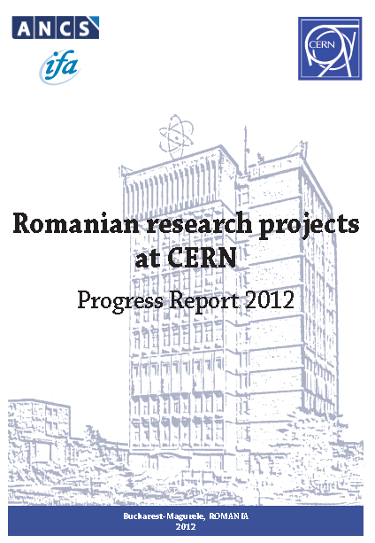
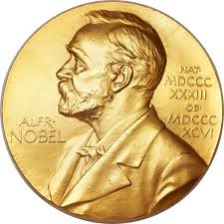
Brosura RO-CERN

Slide 4
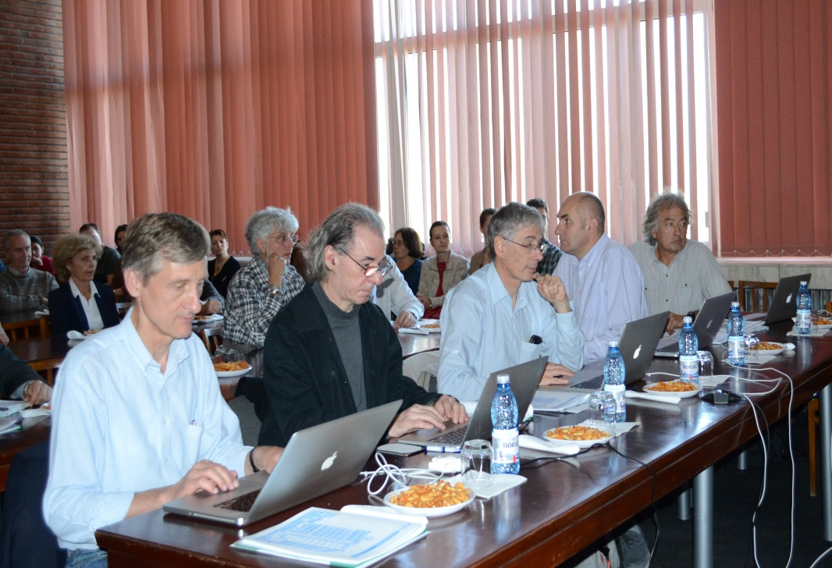
A treia intalnire anuala ISAB – International Scientific Advisory Board
(22-24 octombrie 2013)
Dr. Cristinel Diaconu, Chair ISAB
(CPP Marseille, CNRS, Franta)
Prof. John Harris
(Univ. Yale, USA)
Dr. Philippe Bloch
(CERN , Elvetia)
Dr. Eckhard Elsen
(DESY, Germania)
Prof. François Le Diberder
(Univ. Paris VII, Franta)
De la stanga la dreapta: Dr. Eckhard Elsen, Prof. François Le Diberder, Dr. Philippe Bloch, Dr. Cristinel Diaconu, Prof. John Harris

Slide 5
